Slide 1
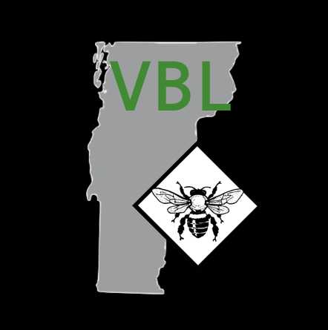
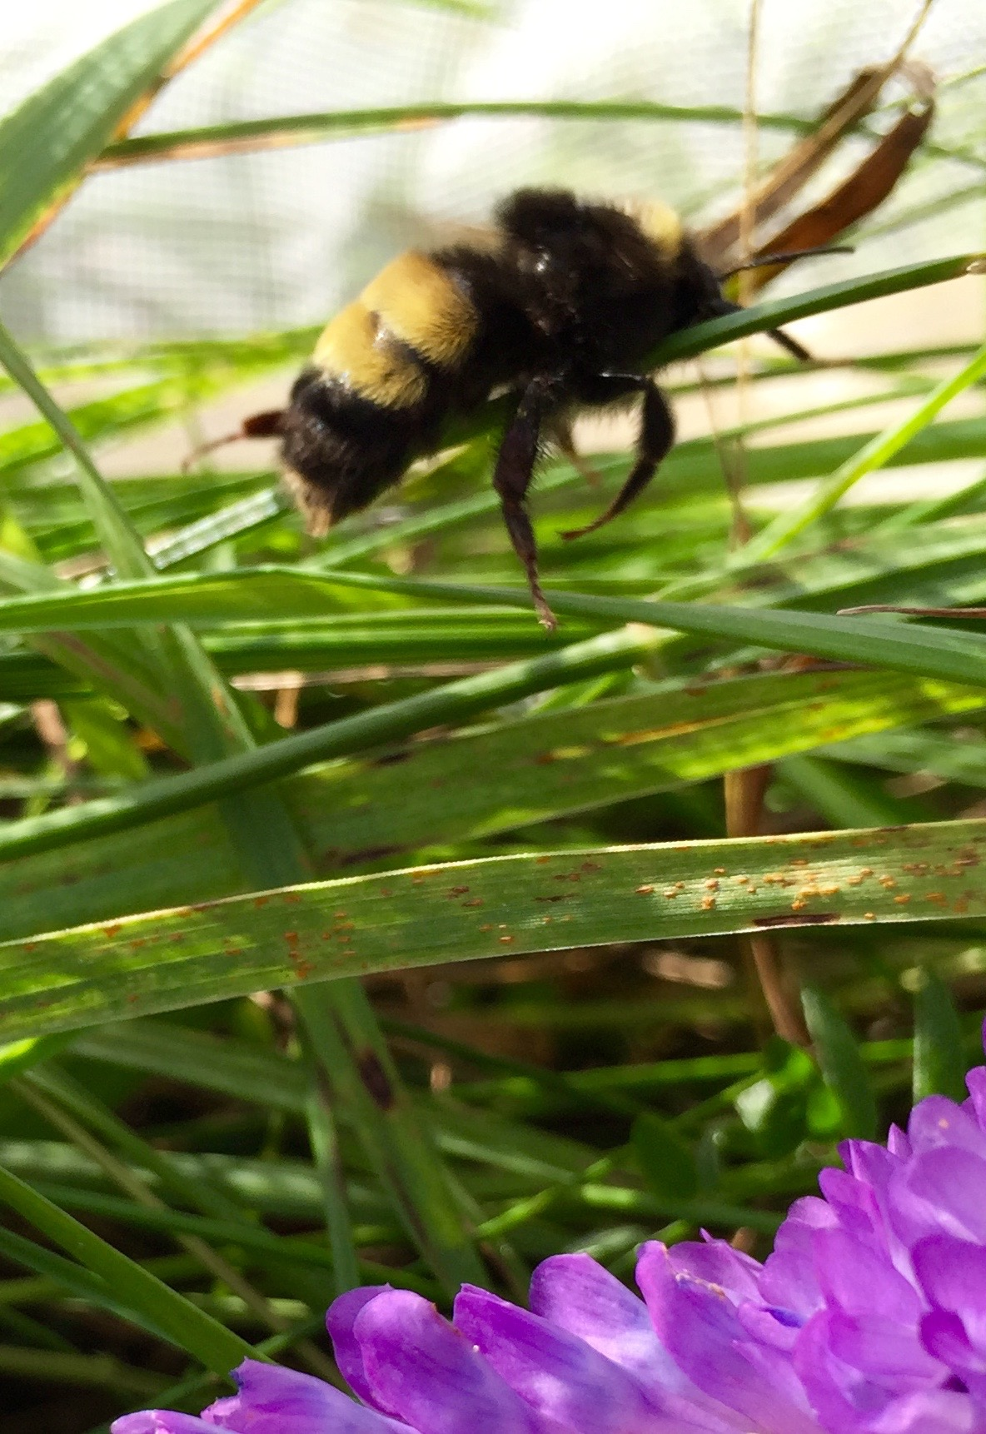
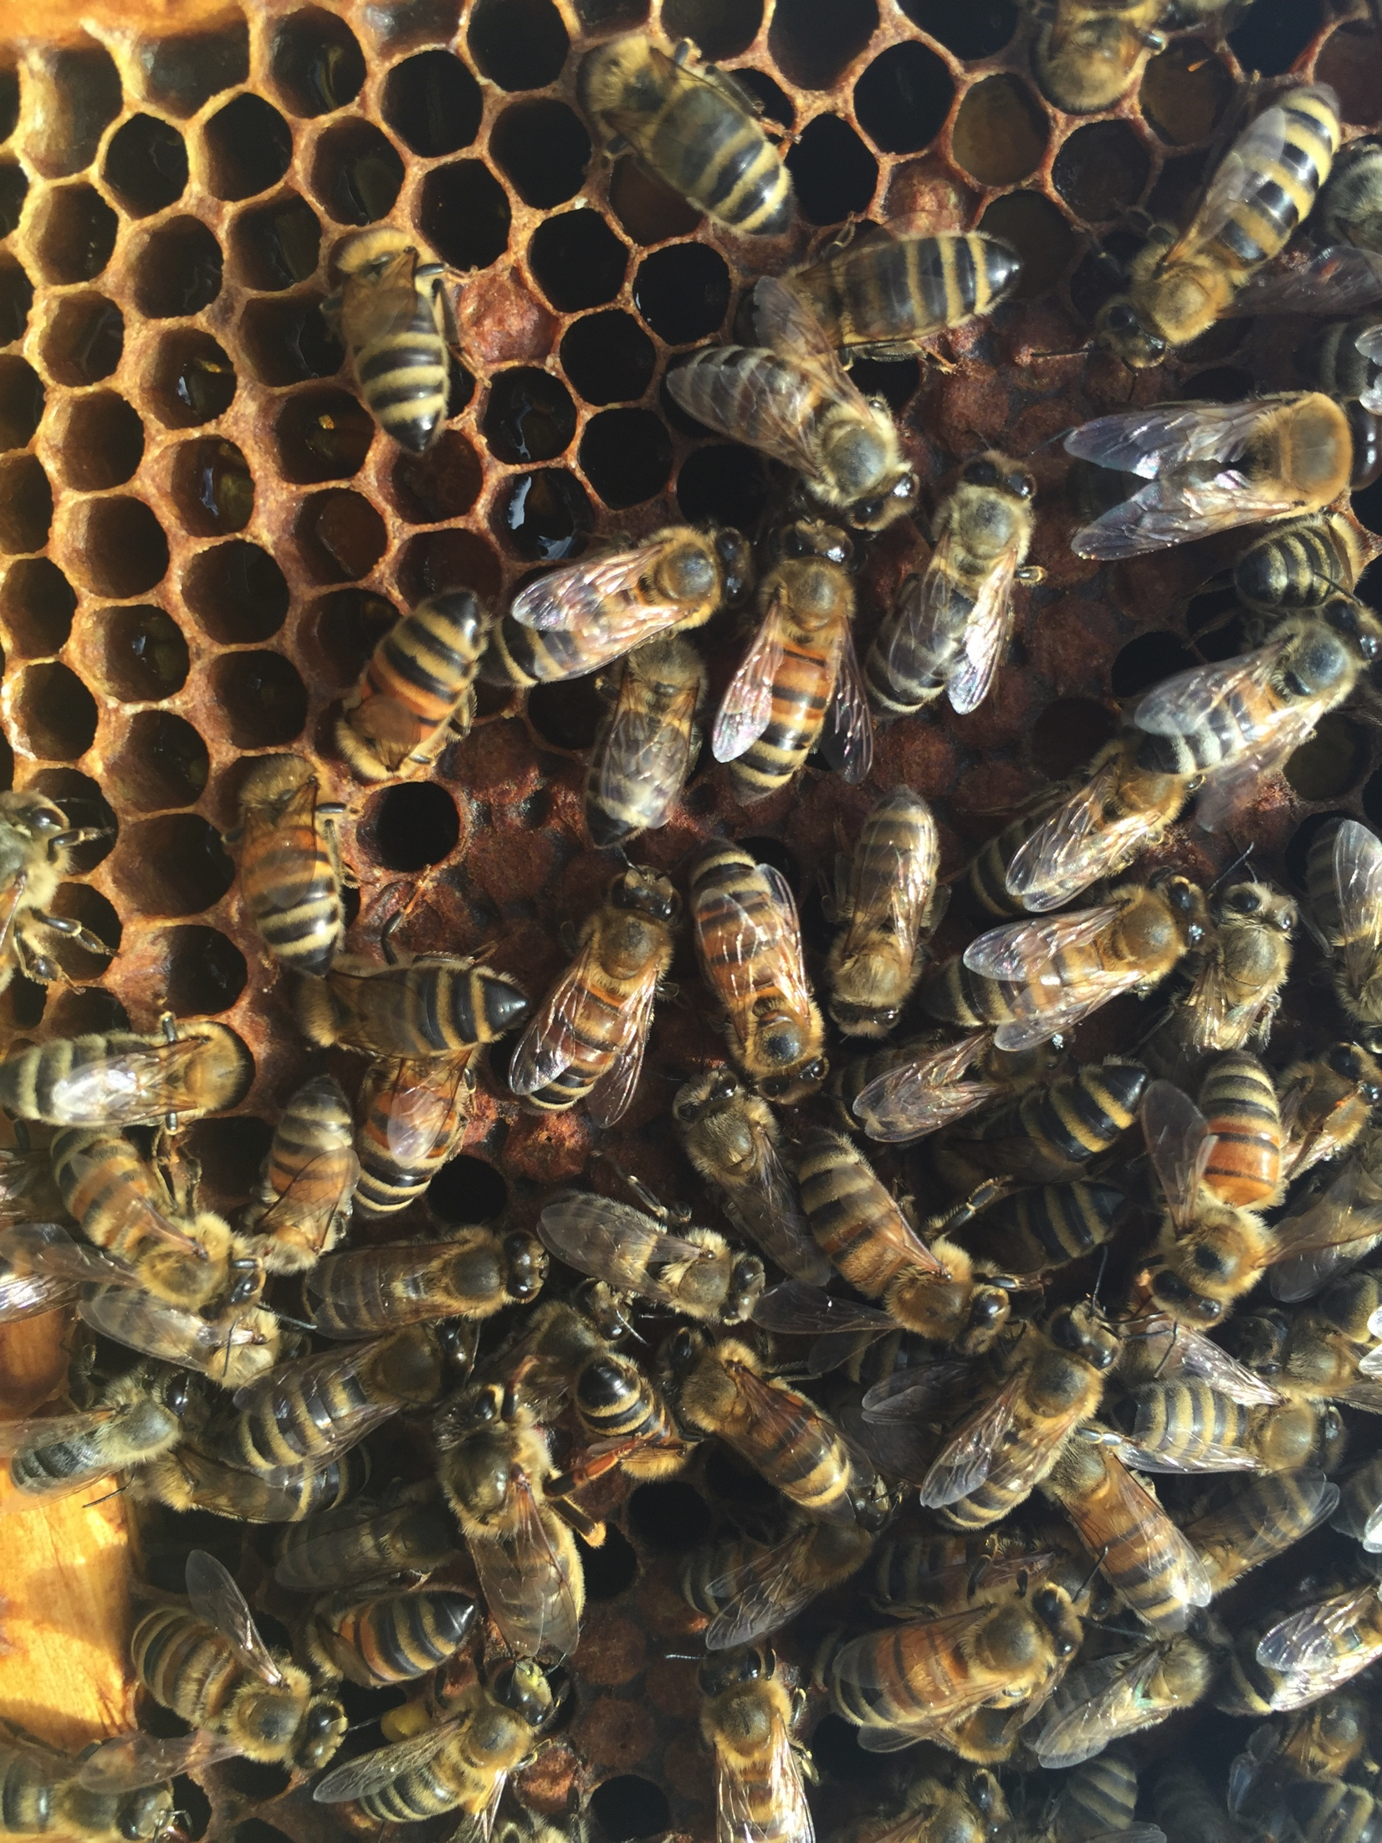
Vermont Bee Lab Research
Samantha Alger
PhD Candidate
Alex Burnham
MS Student
Biology, UVM

Slide 2








Contributors & Collaborators
Alison Brody
Leif Richardson
Anna Smith
Caitlin Danehy
Andrew Nguyen
Joseph Schall
Steve Parise & Drew Harding
David Tremblay
Shane Madella
Participating Beekeepers & VBA
Fabri Fialho Research Award
Ronald Suiter Travel Prize

Slide 3
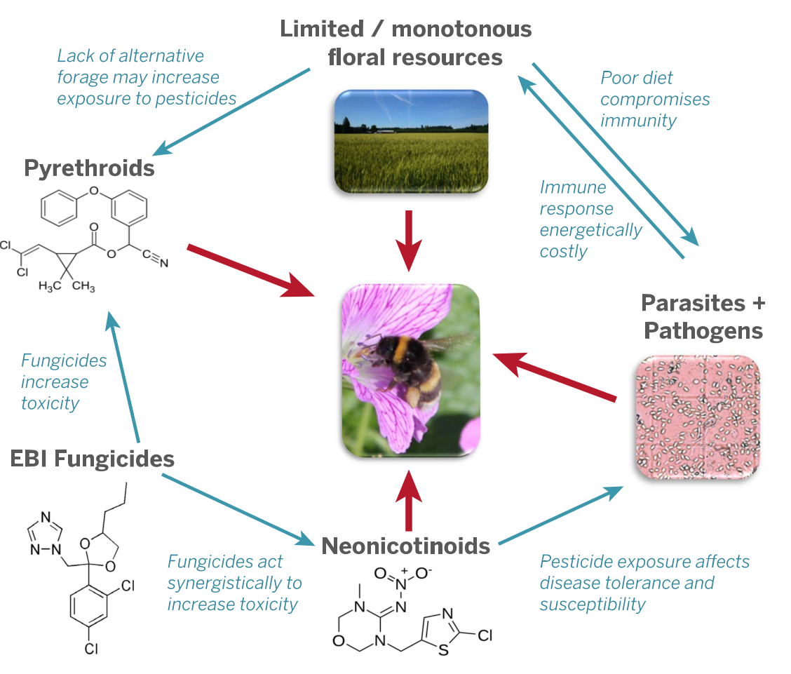
Modified from Goulson et al., 2015

Slide 4
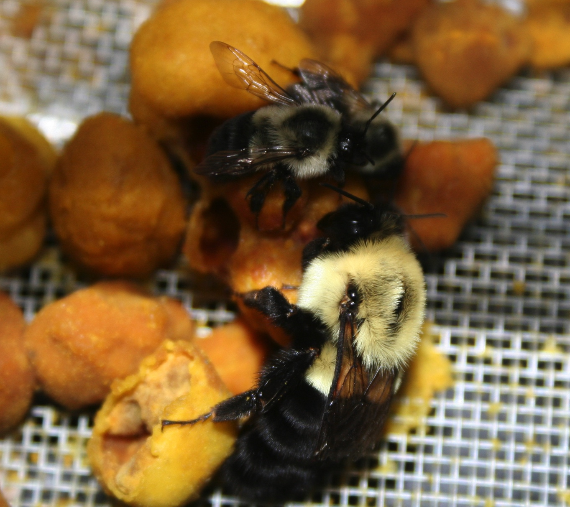
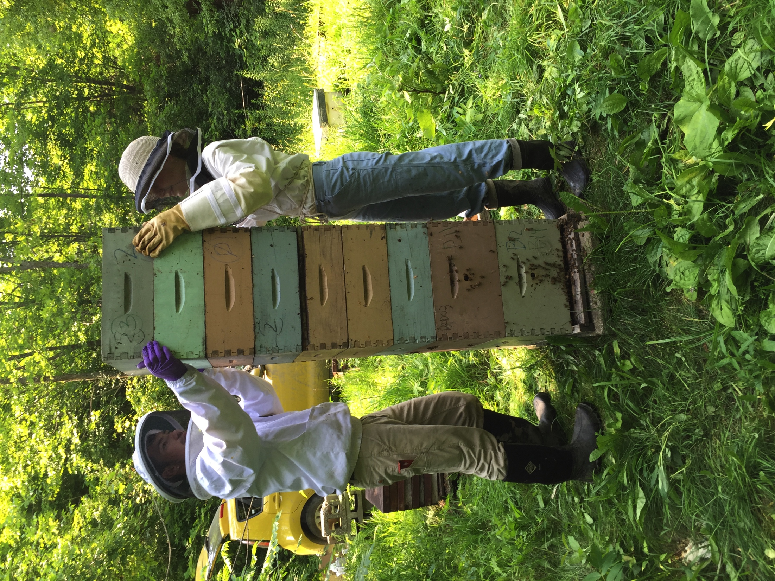
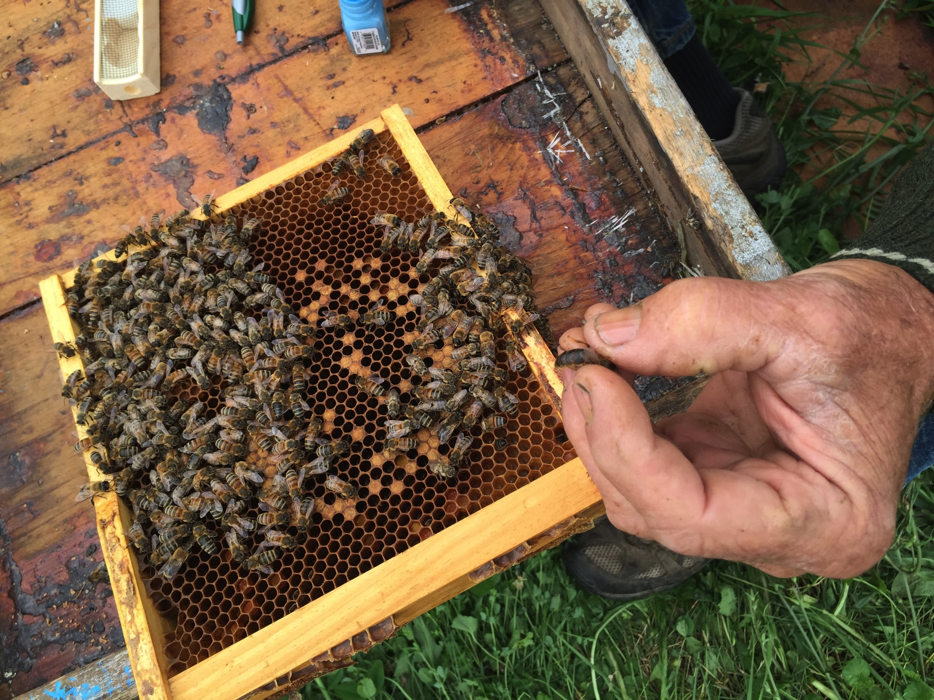
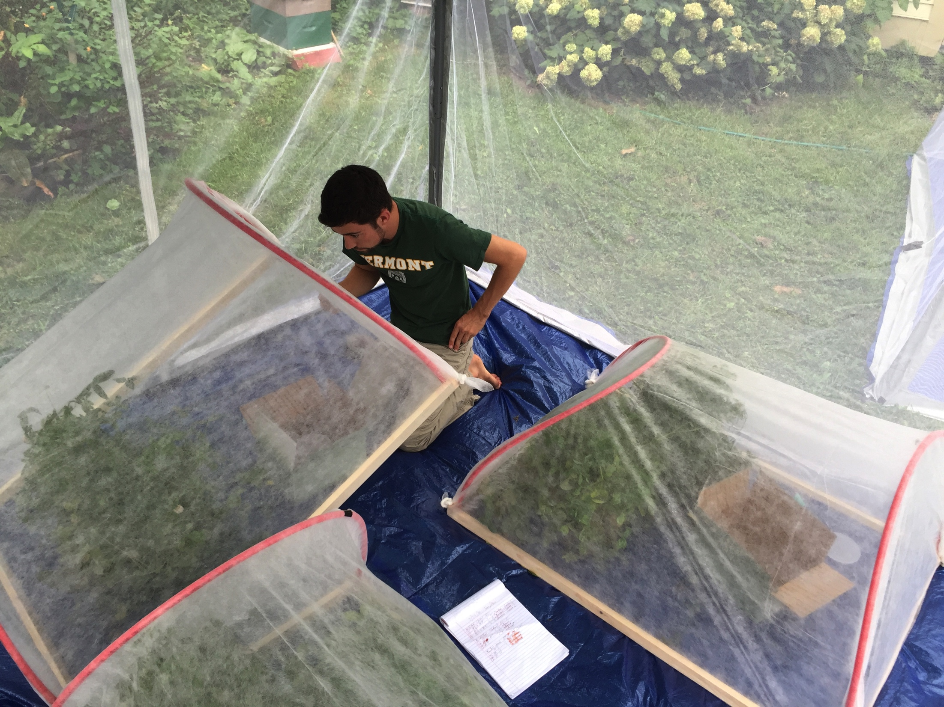

Slide 5
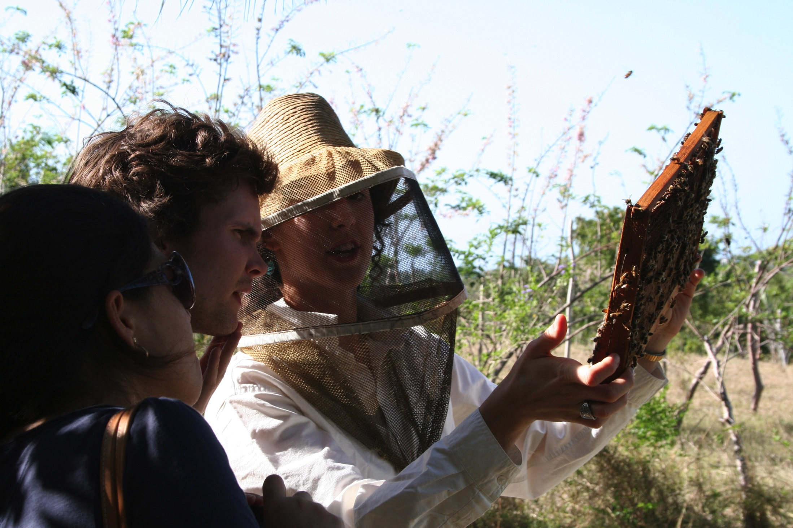
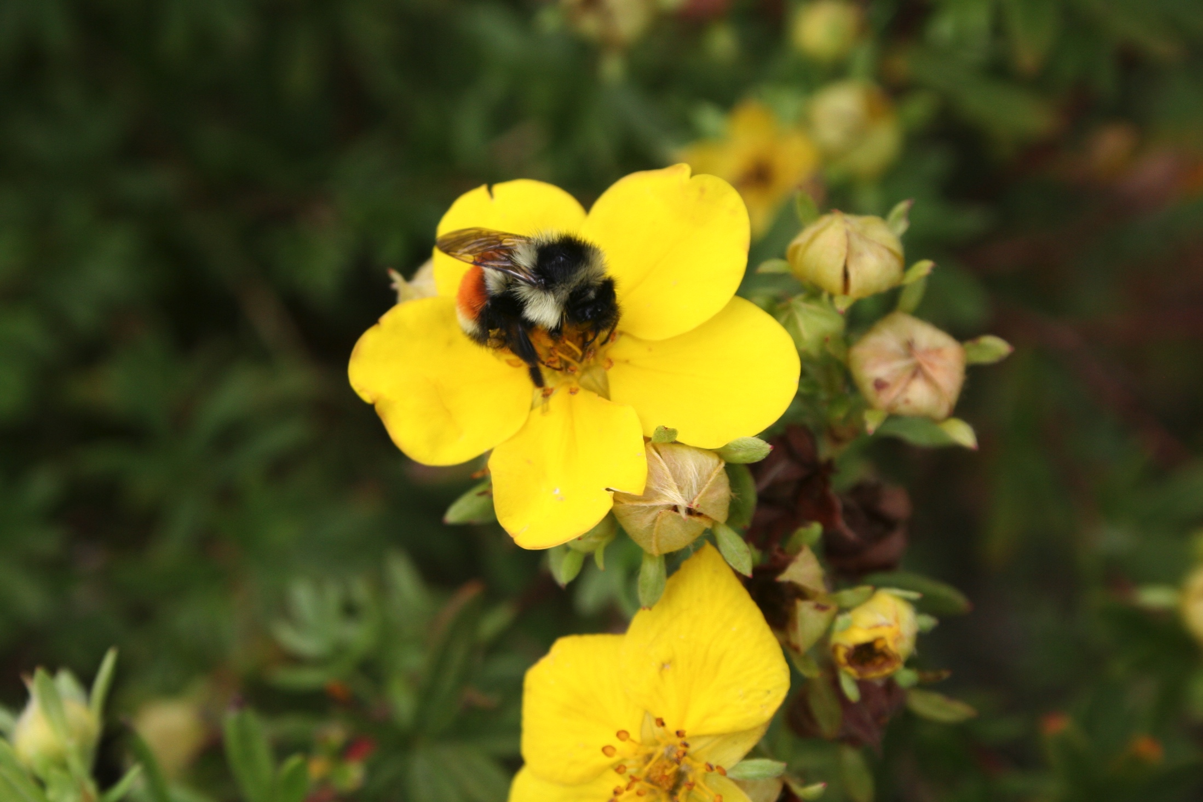
Vermont Bee Lab Research
National Honey Bee Survey
Migratory Beekeeping Study
Bumble Bee Disease Surveys
Modeling Bee Disease
Virus Transmission Experiment
Overwintering Queen Study
Bee Disease Survey in Cuba

Slide 6
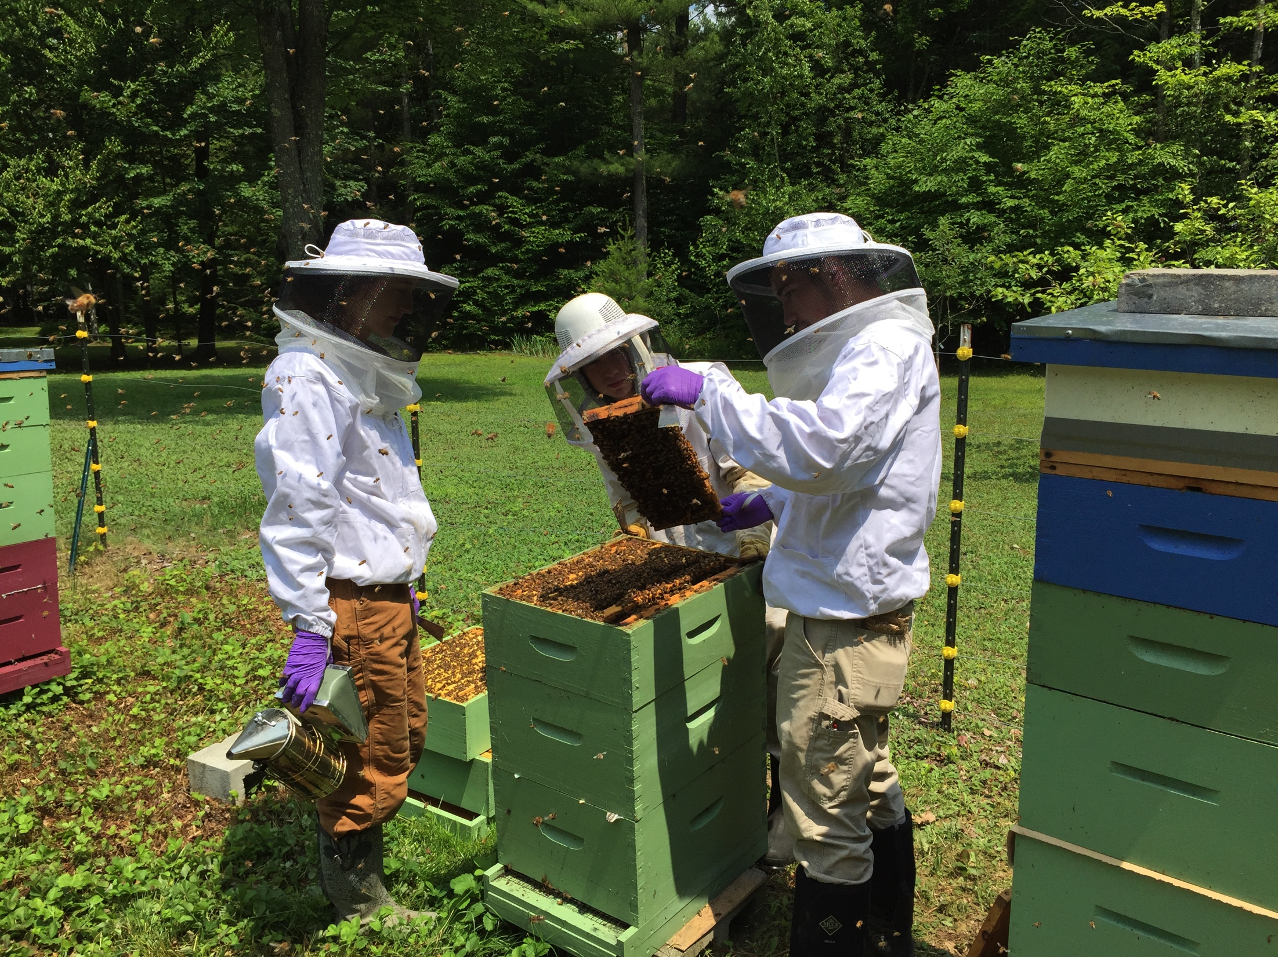
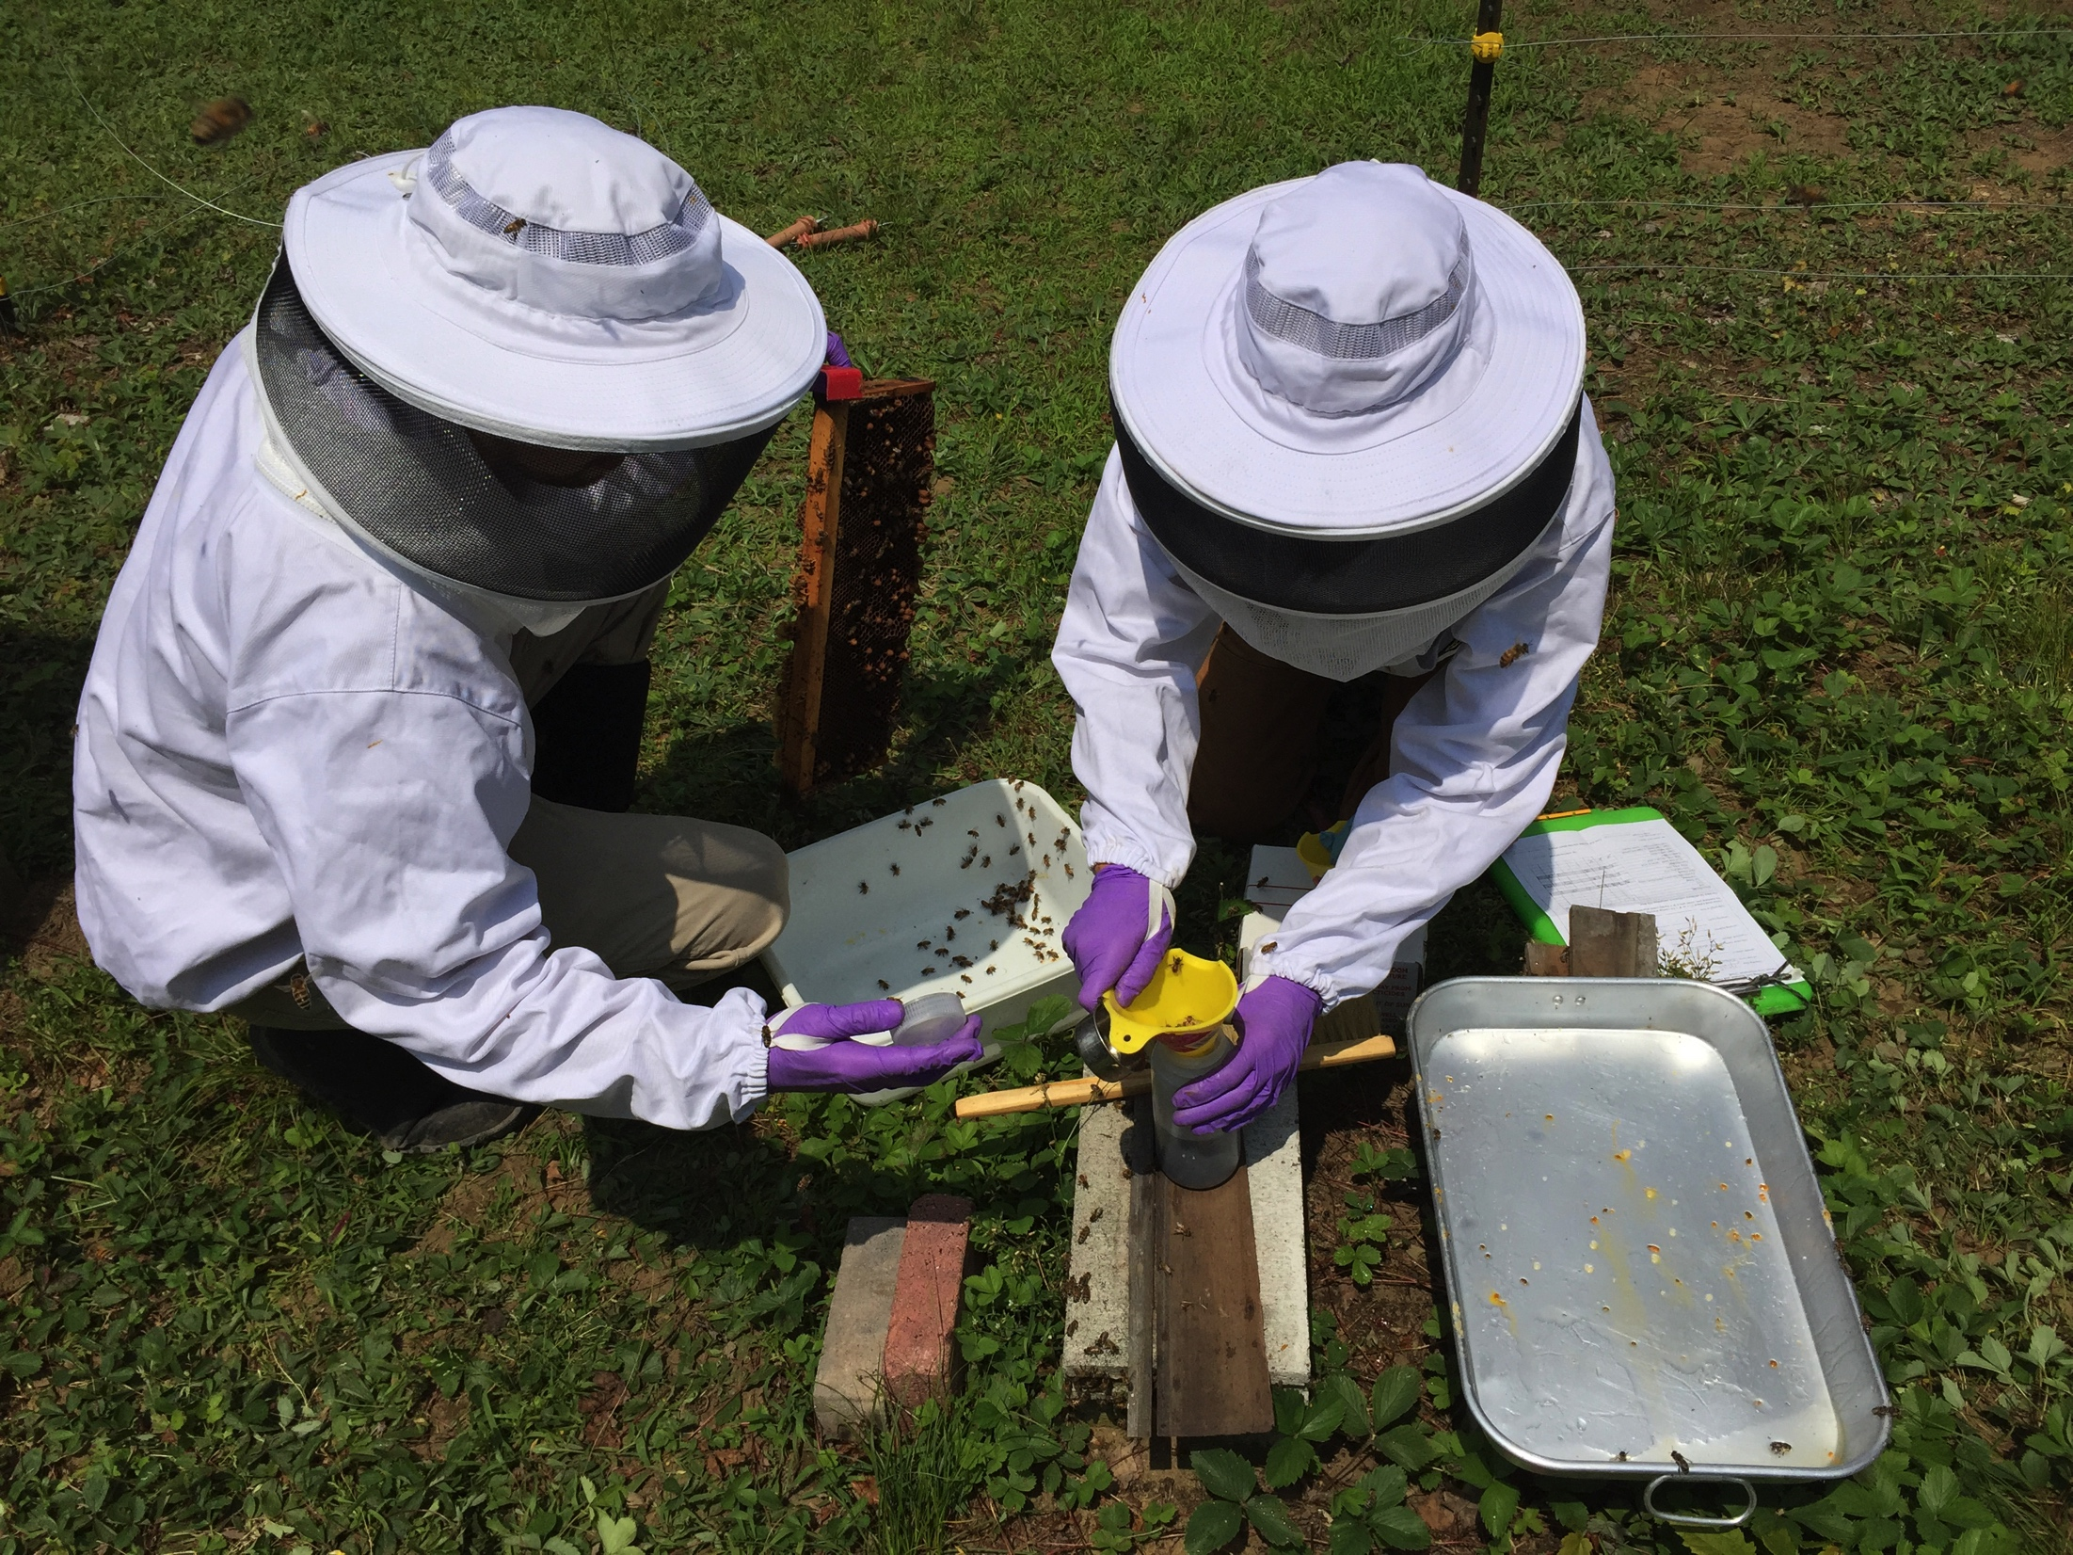

US National Honey Bee Survey
Photos: Mike Willard

Slide 7
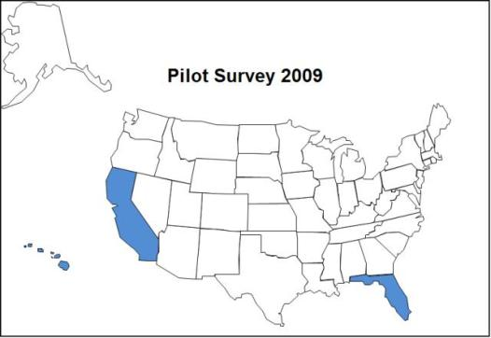
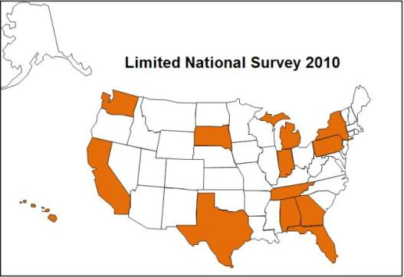
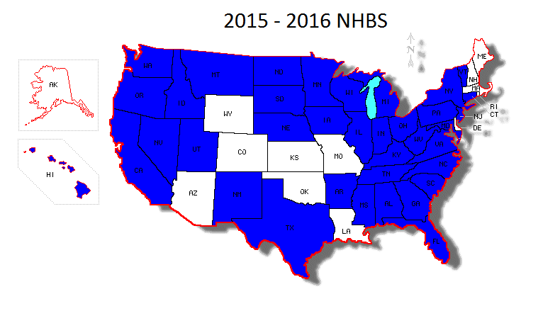
US National Honey Bee Survey
2016
43 states
$12,000 for states to collect
Funding for pesticide testing
Notes:
Explain Maps
Add US

Slide 8
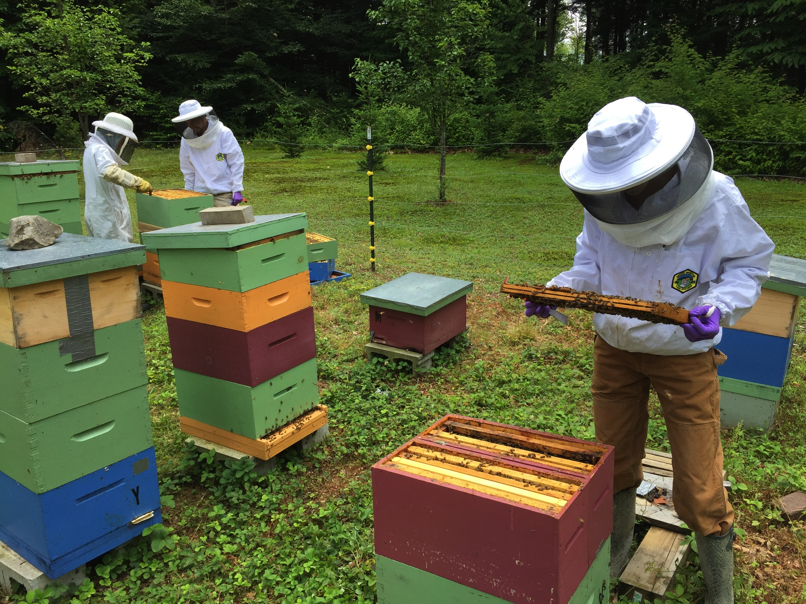
Methods
24 Apiaries Sampled per State
8 Hives Sampled per Apiary
Composite Samples
3 Sample Methods
Alcohol “Wet” Sample
Live Bee Sample
Tropilaelaps “Bump” Sample
10 Pollen Samples for Pesticides (2016)
Notes:
Name Samples

Slide 9
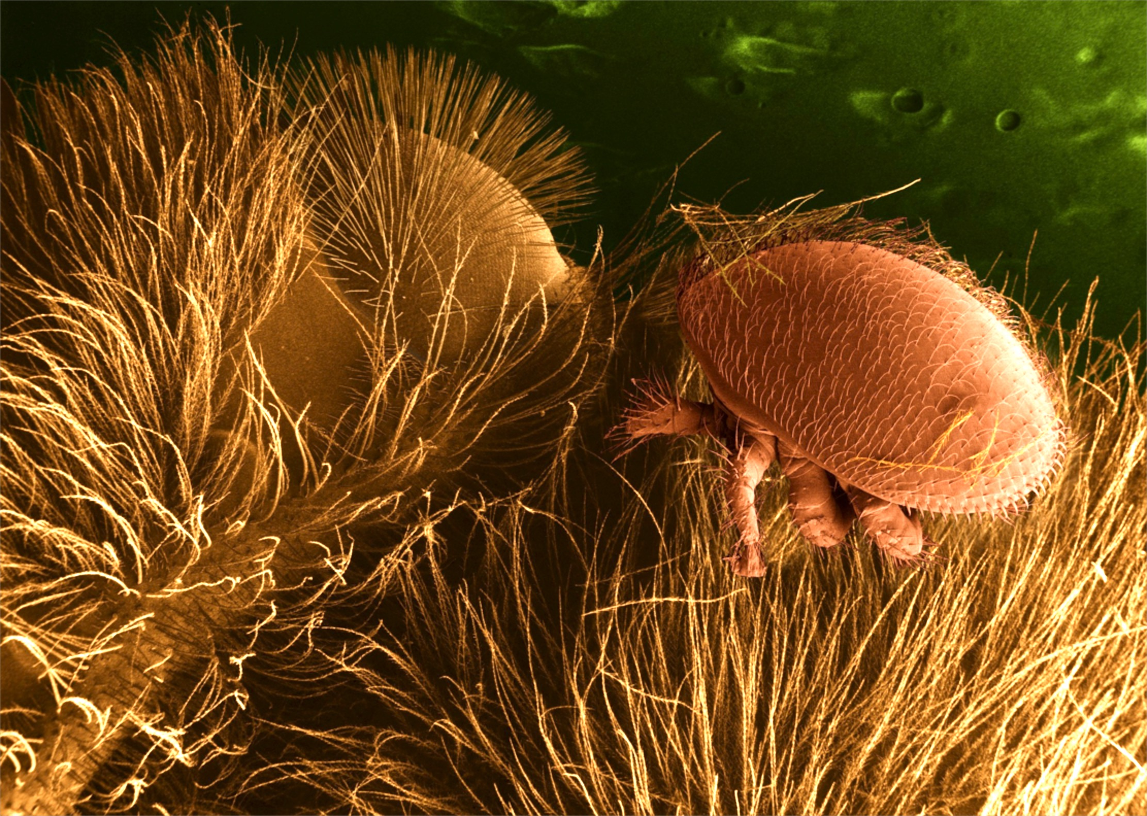
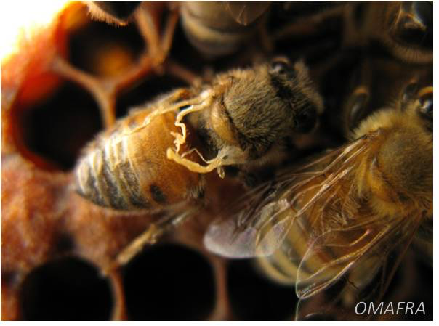
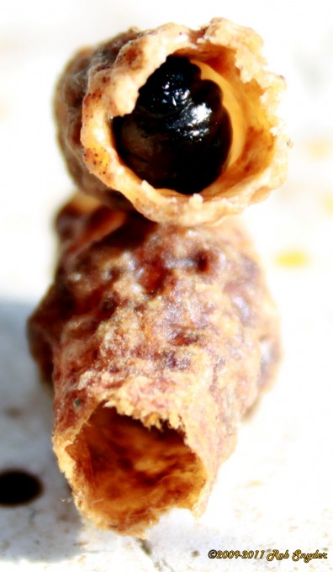
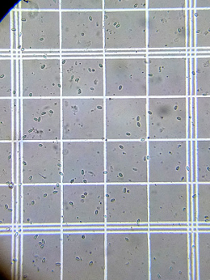
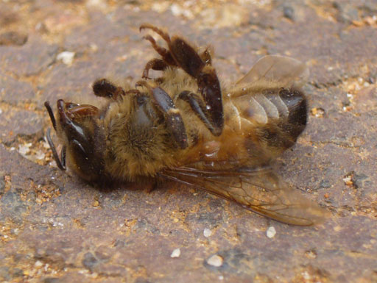
Varroa Mites
RNA Viruses
Nosema spp.

Slide 10
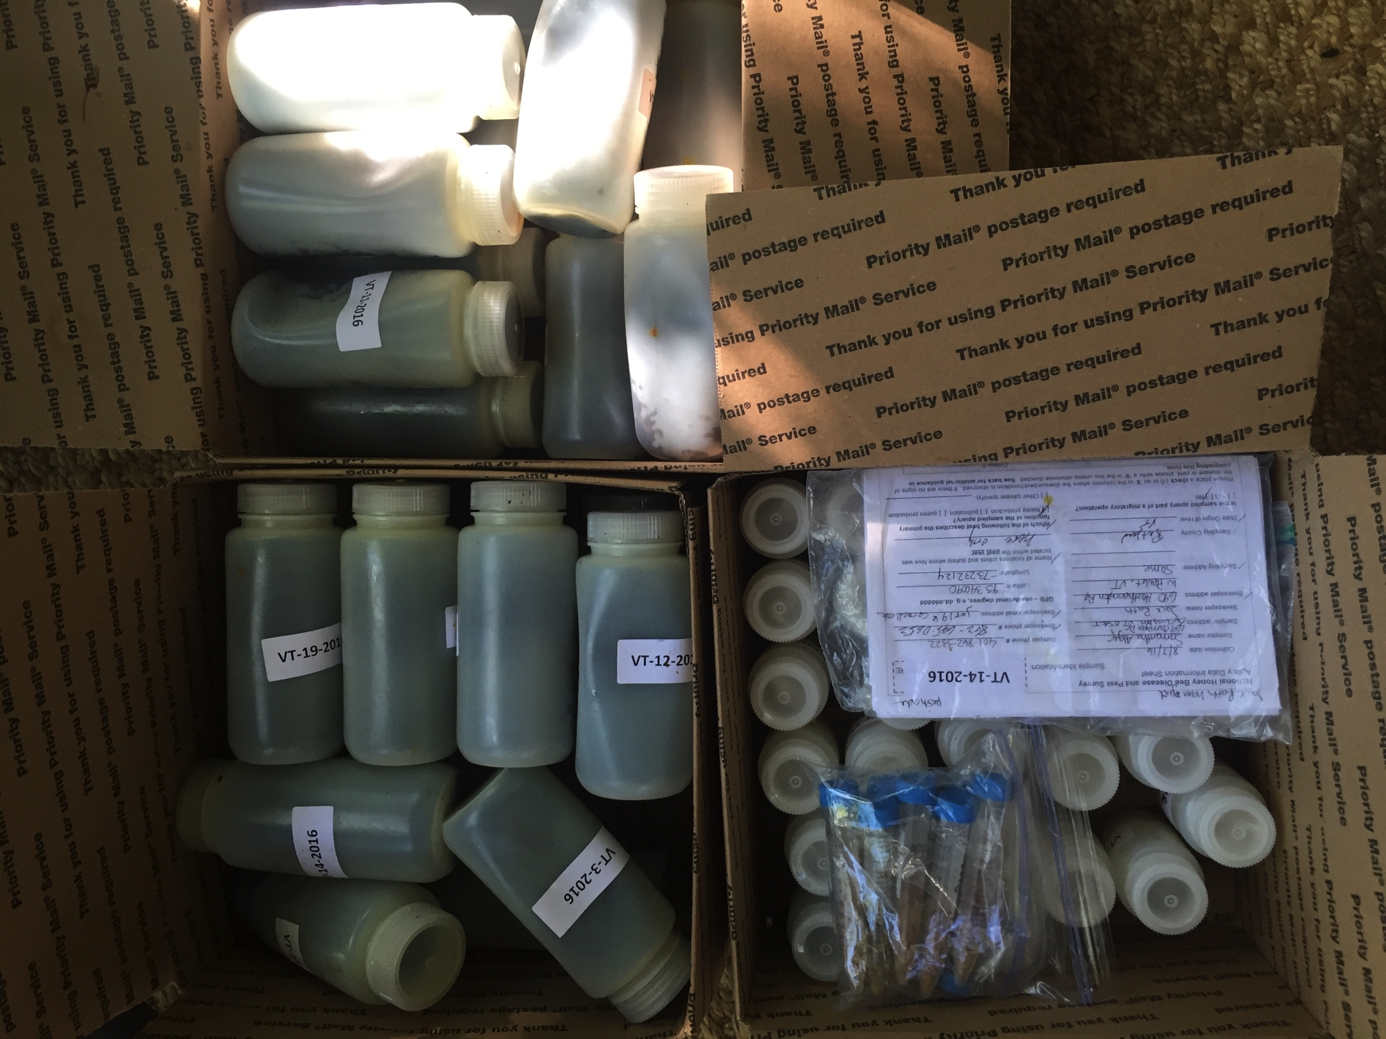
2015 Vermont
24 Apiaries sampled
8 Participating beekeepers
12 Stationary apiaries
12 Migratory apiaries

Slide 11
Nosema
Notes:
Nosema load (million spores/bee) for each of 24 apiaries sampled. 14 of the 24 apiaries were positive for Nosema with only one apiary above the threshold for safe Nosema levels, signified by red line (1 million spores/bee).

Slide 12
Varroa Mite Load
Notes:
Mite load results for each of 24 apiaries sampled. All honey bee apiaries were positive for Varroa mites with 58% (14 of 24 apiaries) having mite loads above the threshold for safe mite levels, signified by red line (3 mites/100 bees).

Slide 13
Varroa Mite Load by Apiary Type
Notes:
Mite loads by operation type. Migratory apiaries had significantly higher mite loads than stationary apiaries (p =0.004).

Slide 14
Virus Load by Apiary Type
Notes:
Mean viral load (virus genome copes/bee) by apiary operation type (migratory or stationary). Bars represent mean standard error. Deformed wing virus (DWV) load was significantly higher in migratory than stationary operations (p = 0.04). Although not statistically significant, viral loads for chronic bee paralysis virus (CBPV) and Lake Sinai virus (LSV2) were also higher for migratory yards.

Slide 15
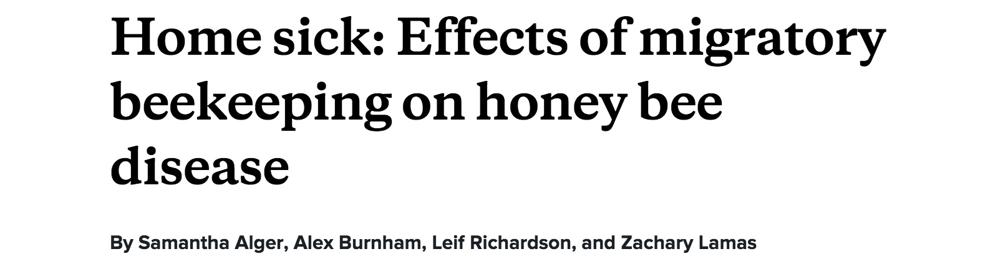

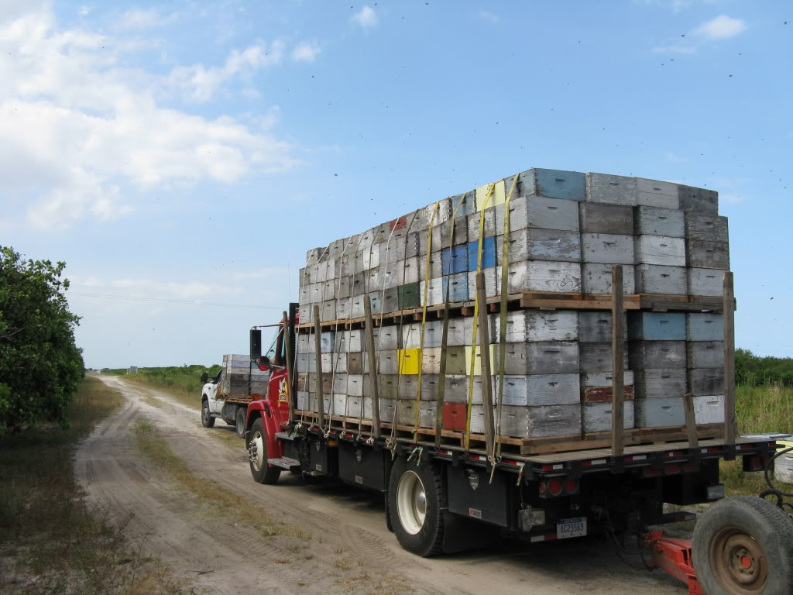
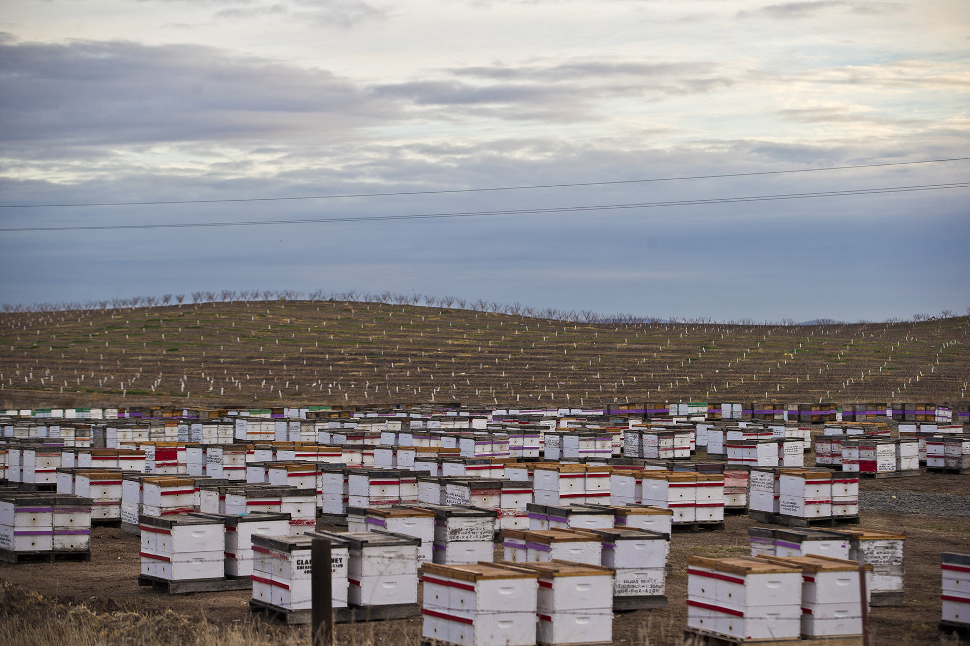
experiment.com\beekeeping

Slide 16
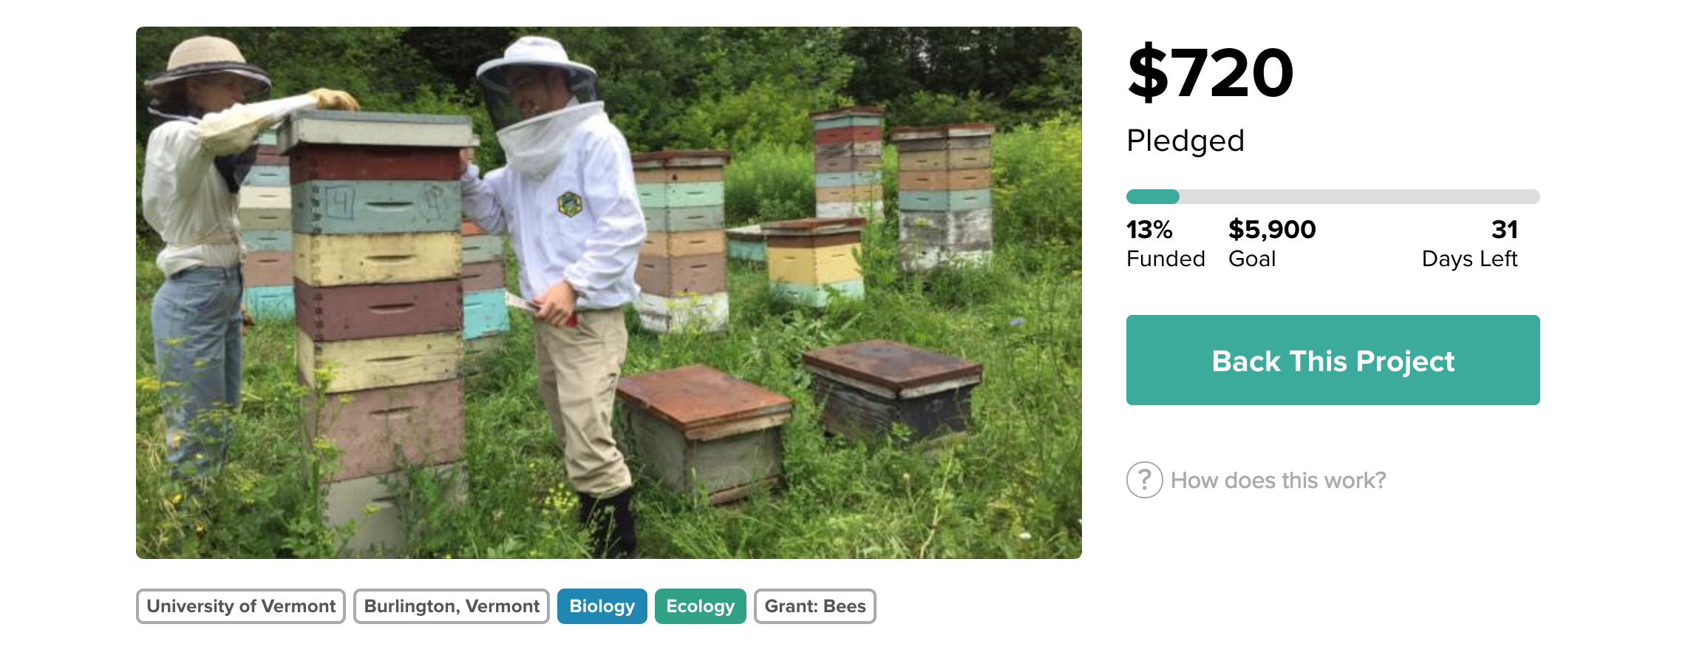
experiment.com\beekeeping

Slide 17
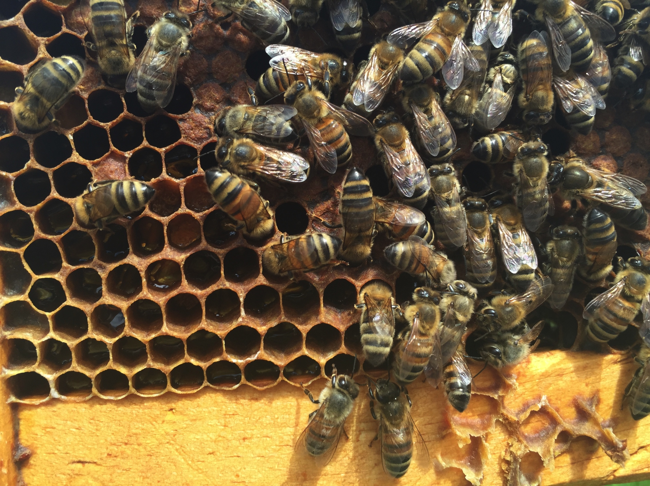
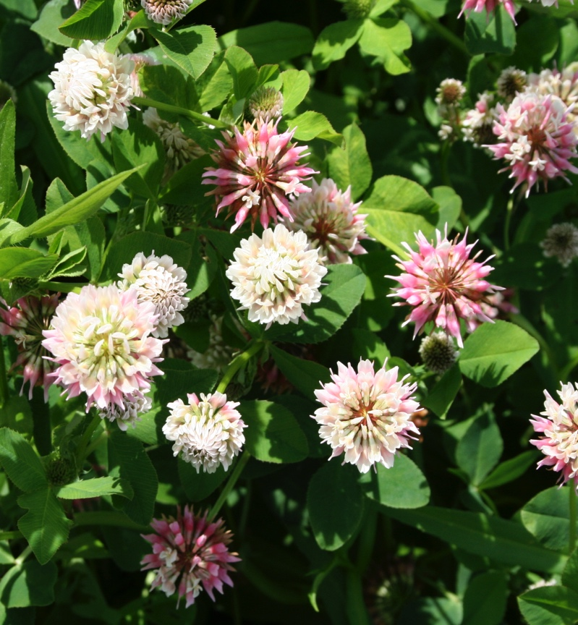
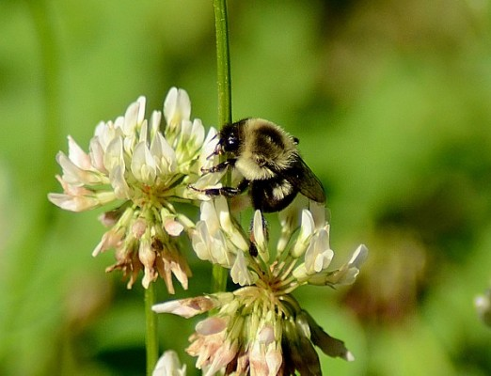
Singh et al., 2010; Fürst et al., 2014; McMahon et al., 2015; Graystock et al., 2015
Notes:
One proposed transmission route between bee species is through the use of shared floral resources. A single experiment demonstrated this route but it remains largely untested. So here’s a diagram depicting these routes: With varroa vectoring viruses to honey bees, and viruses getting transmitted between managed and wild bees through the use of shared floral resources. When bees forage, they leave behind feces and salivary secretions on flowers- potentially leaving behind viral particles to infect the next forager. Directionality of virus transmission has been difficult to establish. In general, the hypothesis is that the viruses are spilling over from managed honey bees into wild bee populations.

Slide 18
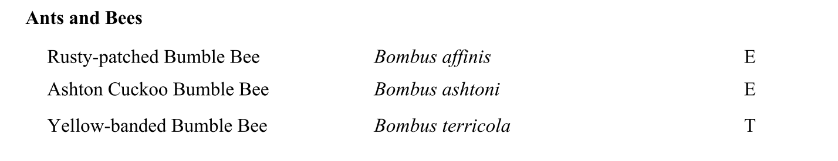
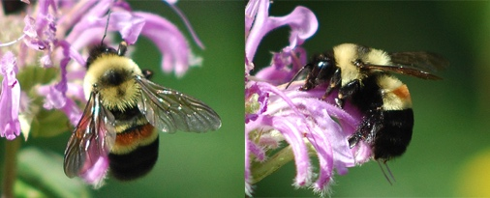
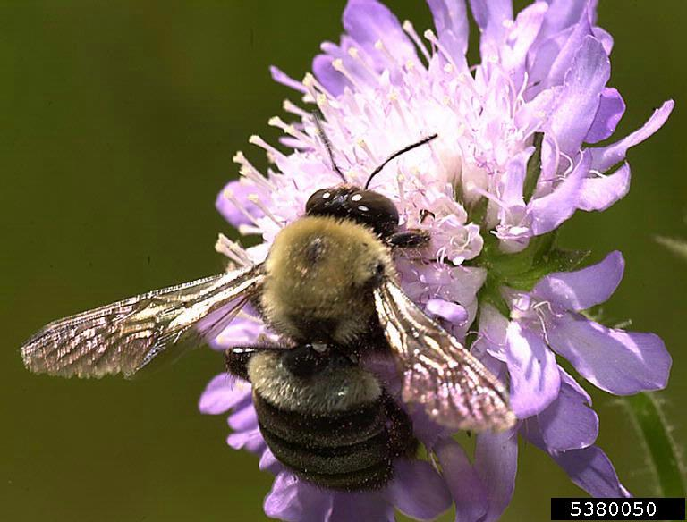
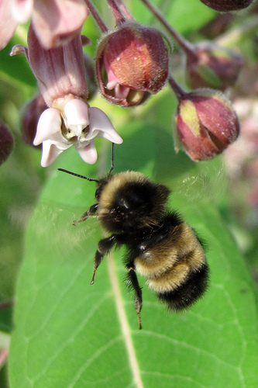
2015: 3 Bumble Bee Species Listed
Johanna James-Heinz
Gary Alpert
nbnc
Vermont Natural Heritage Inventory and VT Fish & Wildlife, 2015

Slide 19
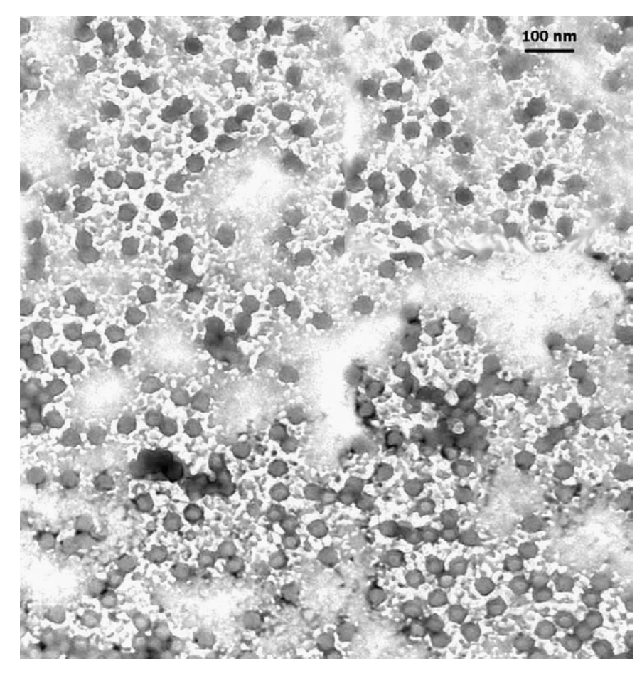
^{Deformed Wing Virus}
^{Black Queen Cell Virus}
^{Israeli Acute Paralysis Virus}
Chen et al., 2004
Notes:
Specifically, I’m researching the single stranded RNA viruses. There are more than 20 viruses known to affect bees, and I’m focusing on three of the most common:
Electron micrograph of virus particles- containing 4 different viruses.

Slide 20
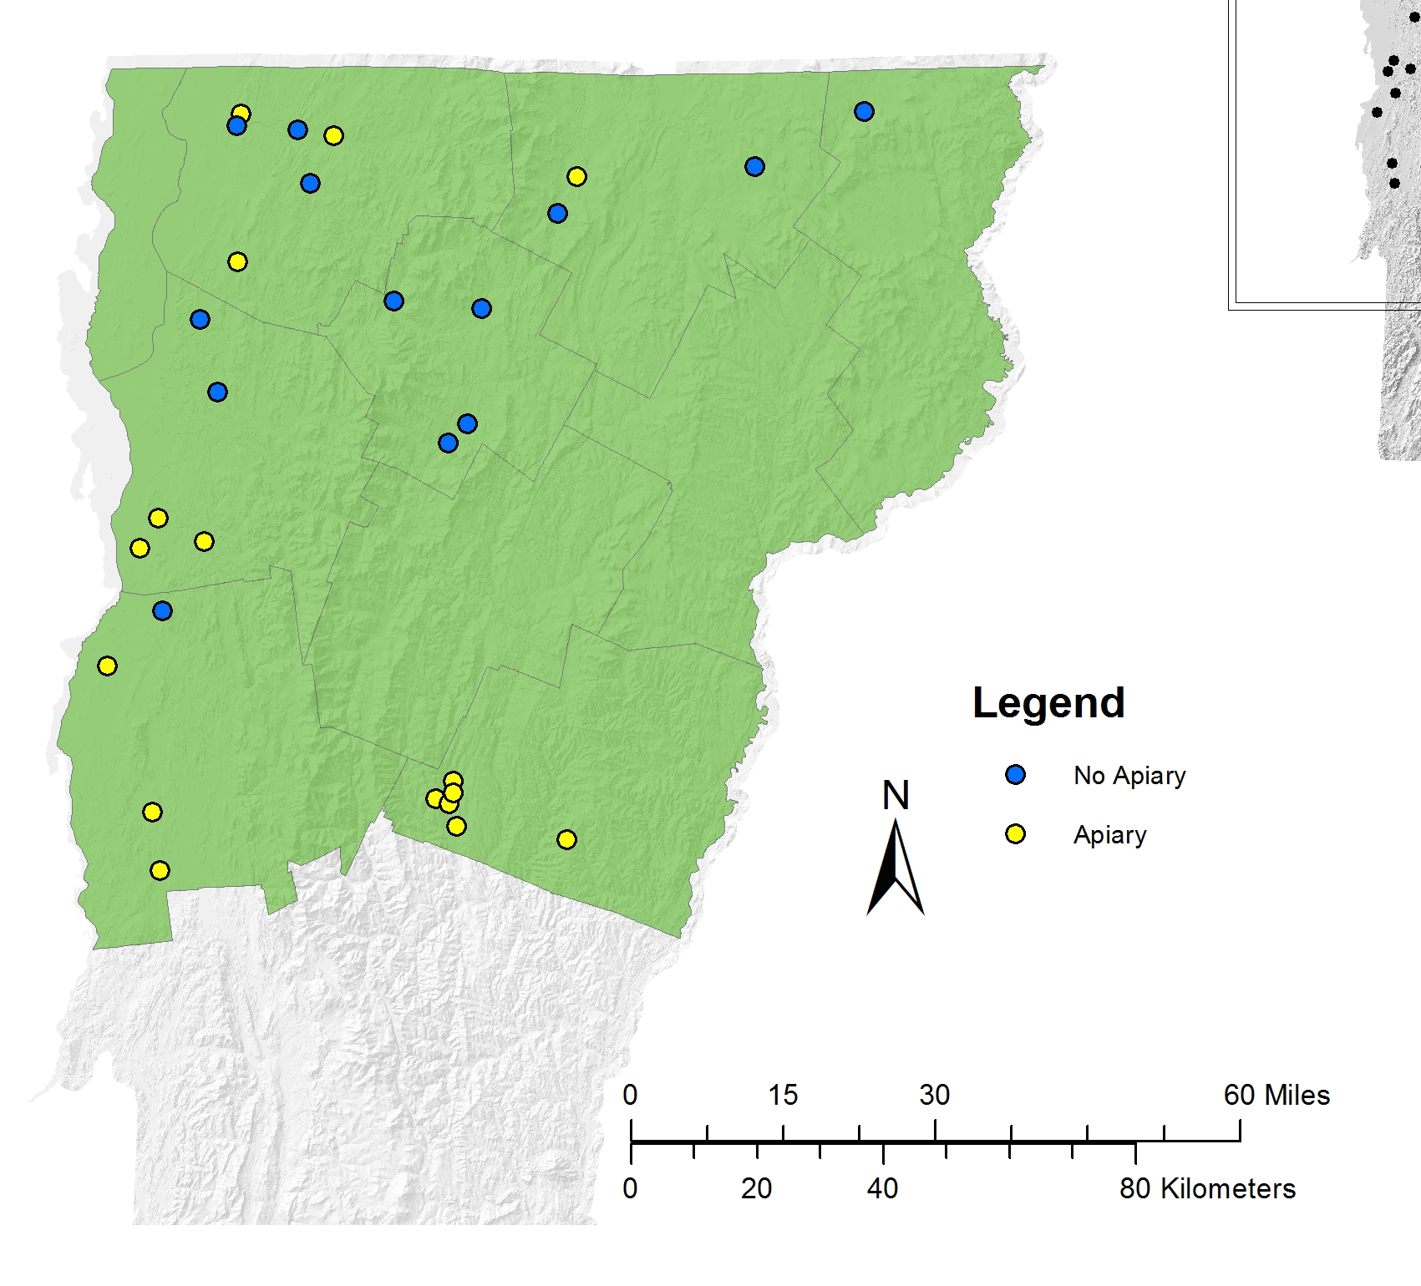
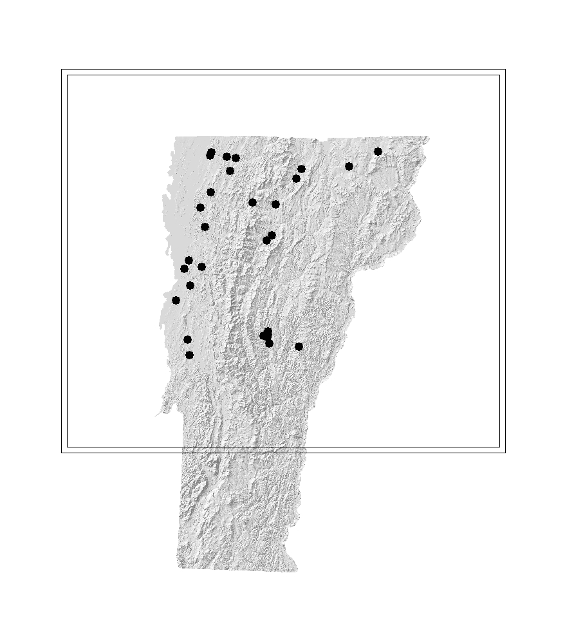
Bumble Bee Surveys

Slide 21
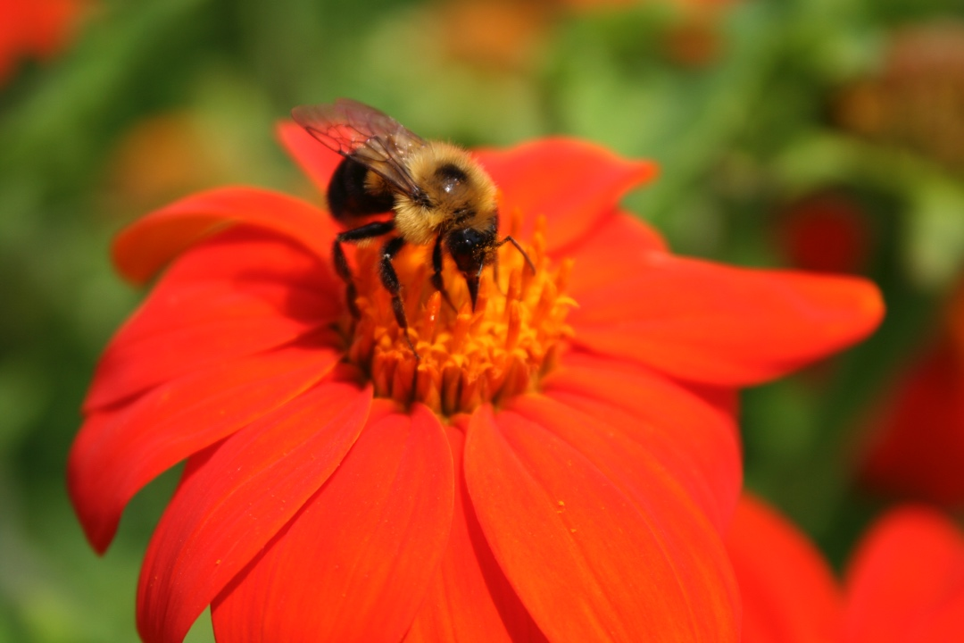
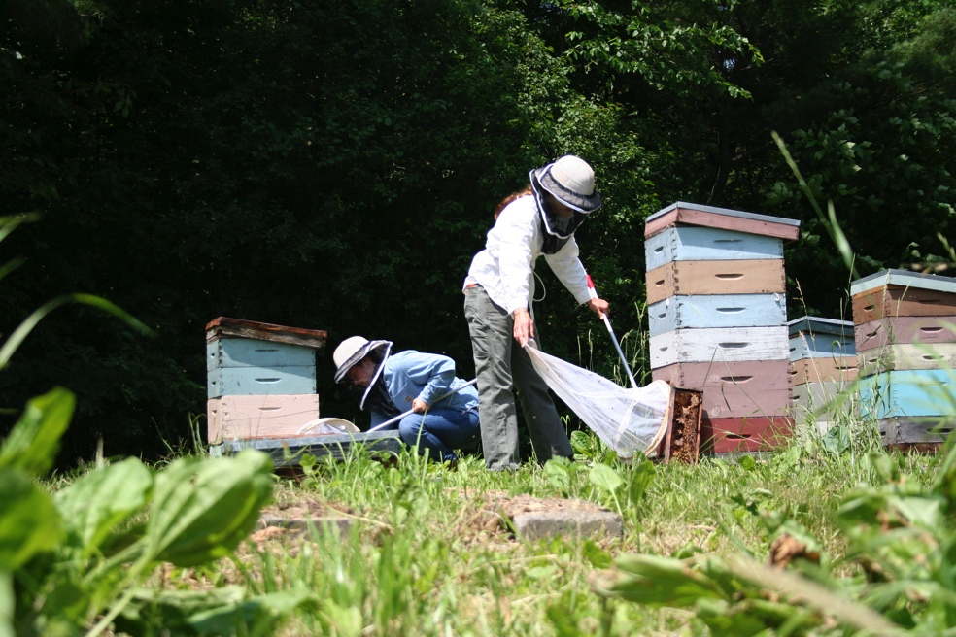
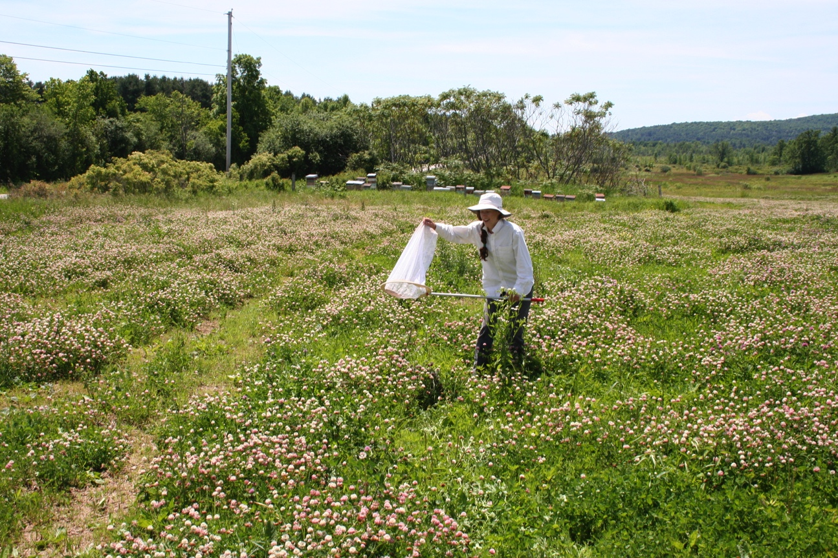
Notes:
At each field site, I collected bumble bees, conducting bee abundance surveys, and flowering vegetation surveys. At sites where honey bees were present, I sampled honeybees. And at some locations, I sampled honeybees straight from the hives.

Slide 22
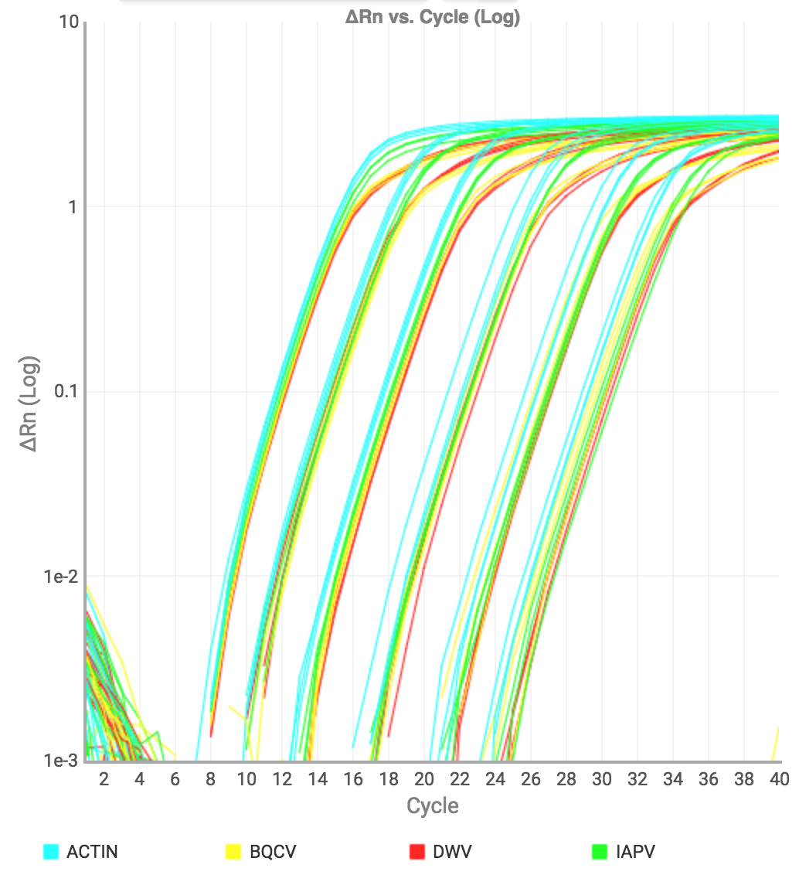
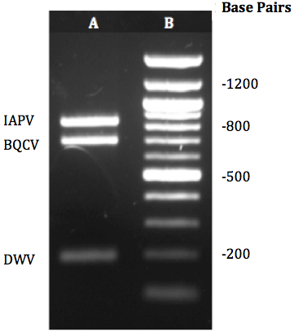
Notes:
Using quantitative PCR, we’ve analyzed a portion of the bees we caught for three different viruses. I’m going to show you some of the results:
Explain qPCR curve

Slide 24
Nosema Transmission Model
Infection Rate
Initial Infection
Rate
Natural
Death
Rate
Natural
Death
Rate
Susceptibles
Defecation Rate 1
Virulence
Nosema
Reservoir
on
landscape
Decay
Critically Infected
Diseased
Death
Rate
Defecation Rate 2

Slide 25
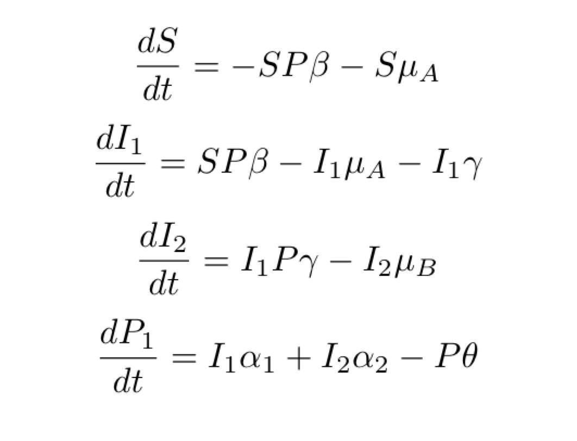
Equations of the model

Slide 26
Initial Model: Infection Rate=0.20, Virulence=0.05, Initial Infected=0.05
Spring
Fall

Slide 27
Change in Initial Infected: Infection Rate=0.20, Virulence=0.05
LOW Initial Infected=0.01
HIGH Initial Infected=0.20
Spring
Fall
Spring
Fall

Slide 28
Role of Flowers in Virus Transmission?
?
Notes:
Now, I’d like to discuss what’s next for my research. I am currently looking at the role of plants in virus transmission. It is assumed that plants act as a sort of ‘dirty doorknob’ in viral transmission: A sick bee will forage on a flower, leaving behind viruses either through salivary secretions or feces. A healthy bee will later land on this contaminated flower to forage and become infected. Although this transmission route is assumed, it has not yet been demonstrated with RNA viruses. Using some preliminary data I collected early on with the GCA fellowship, I designed an experiment and was awarded a grant to examine this transmission route.

Slide 29
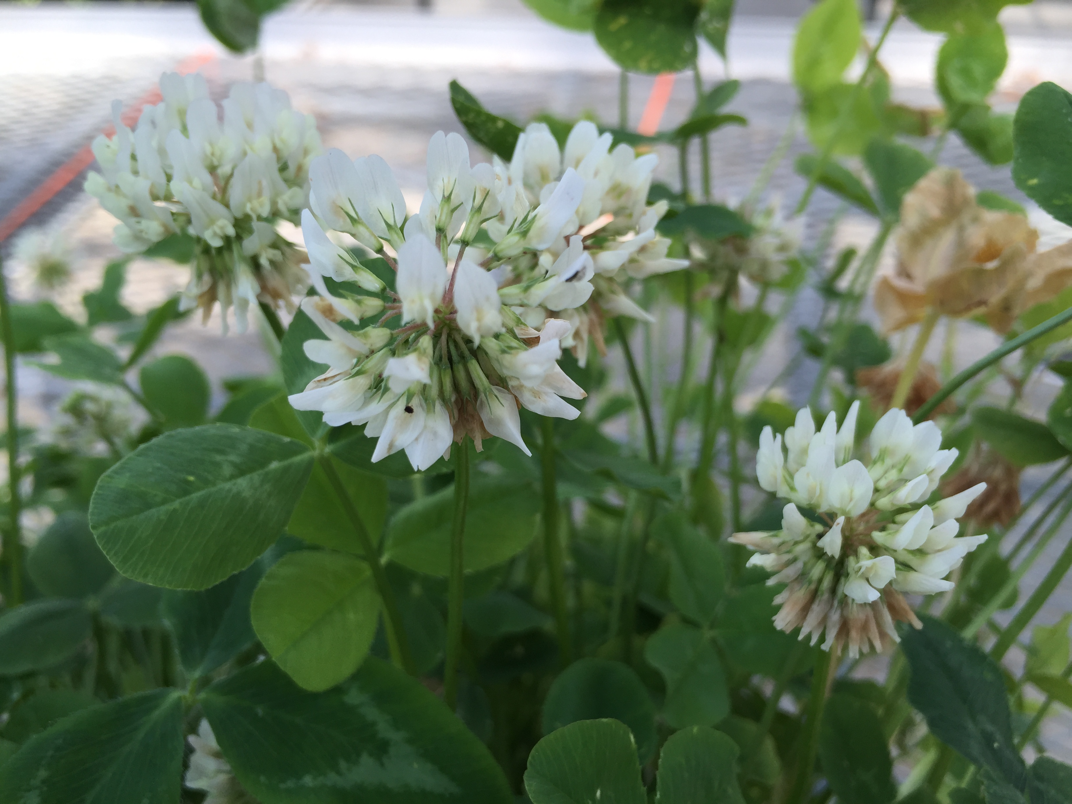
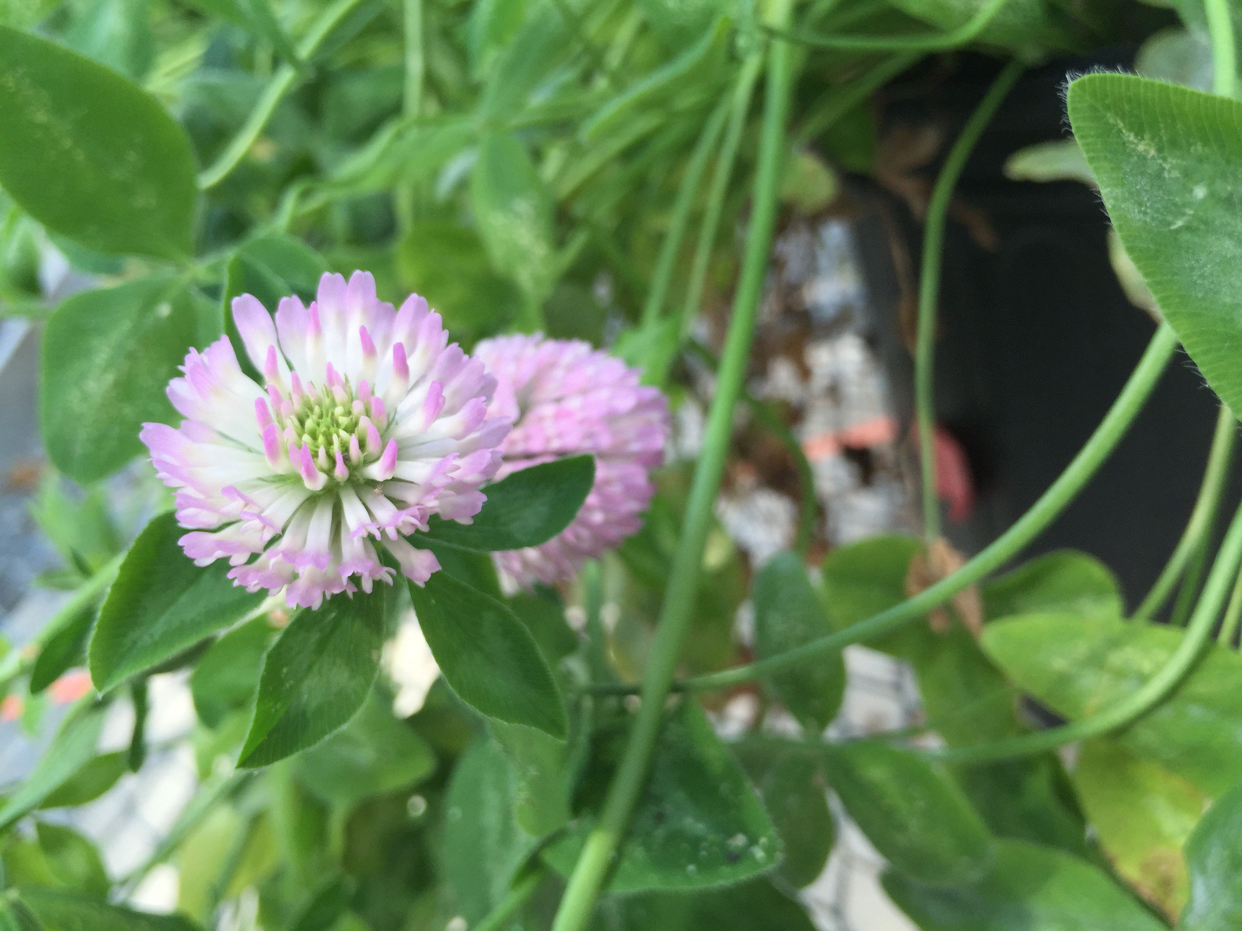
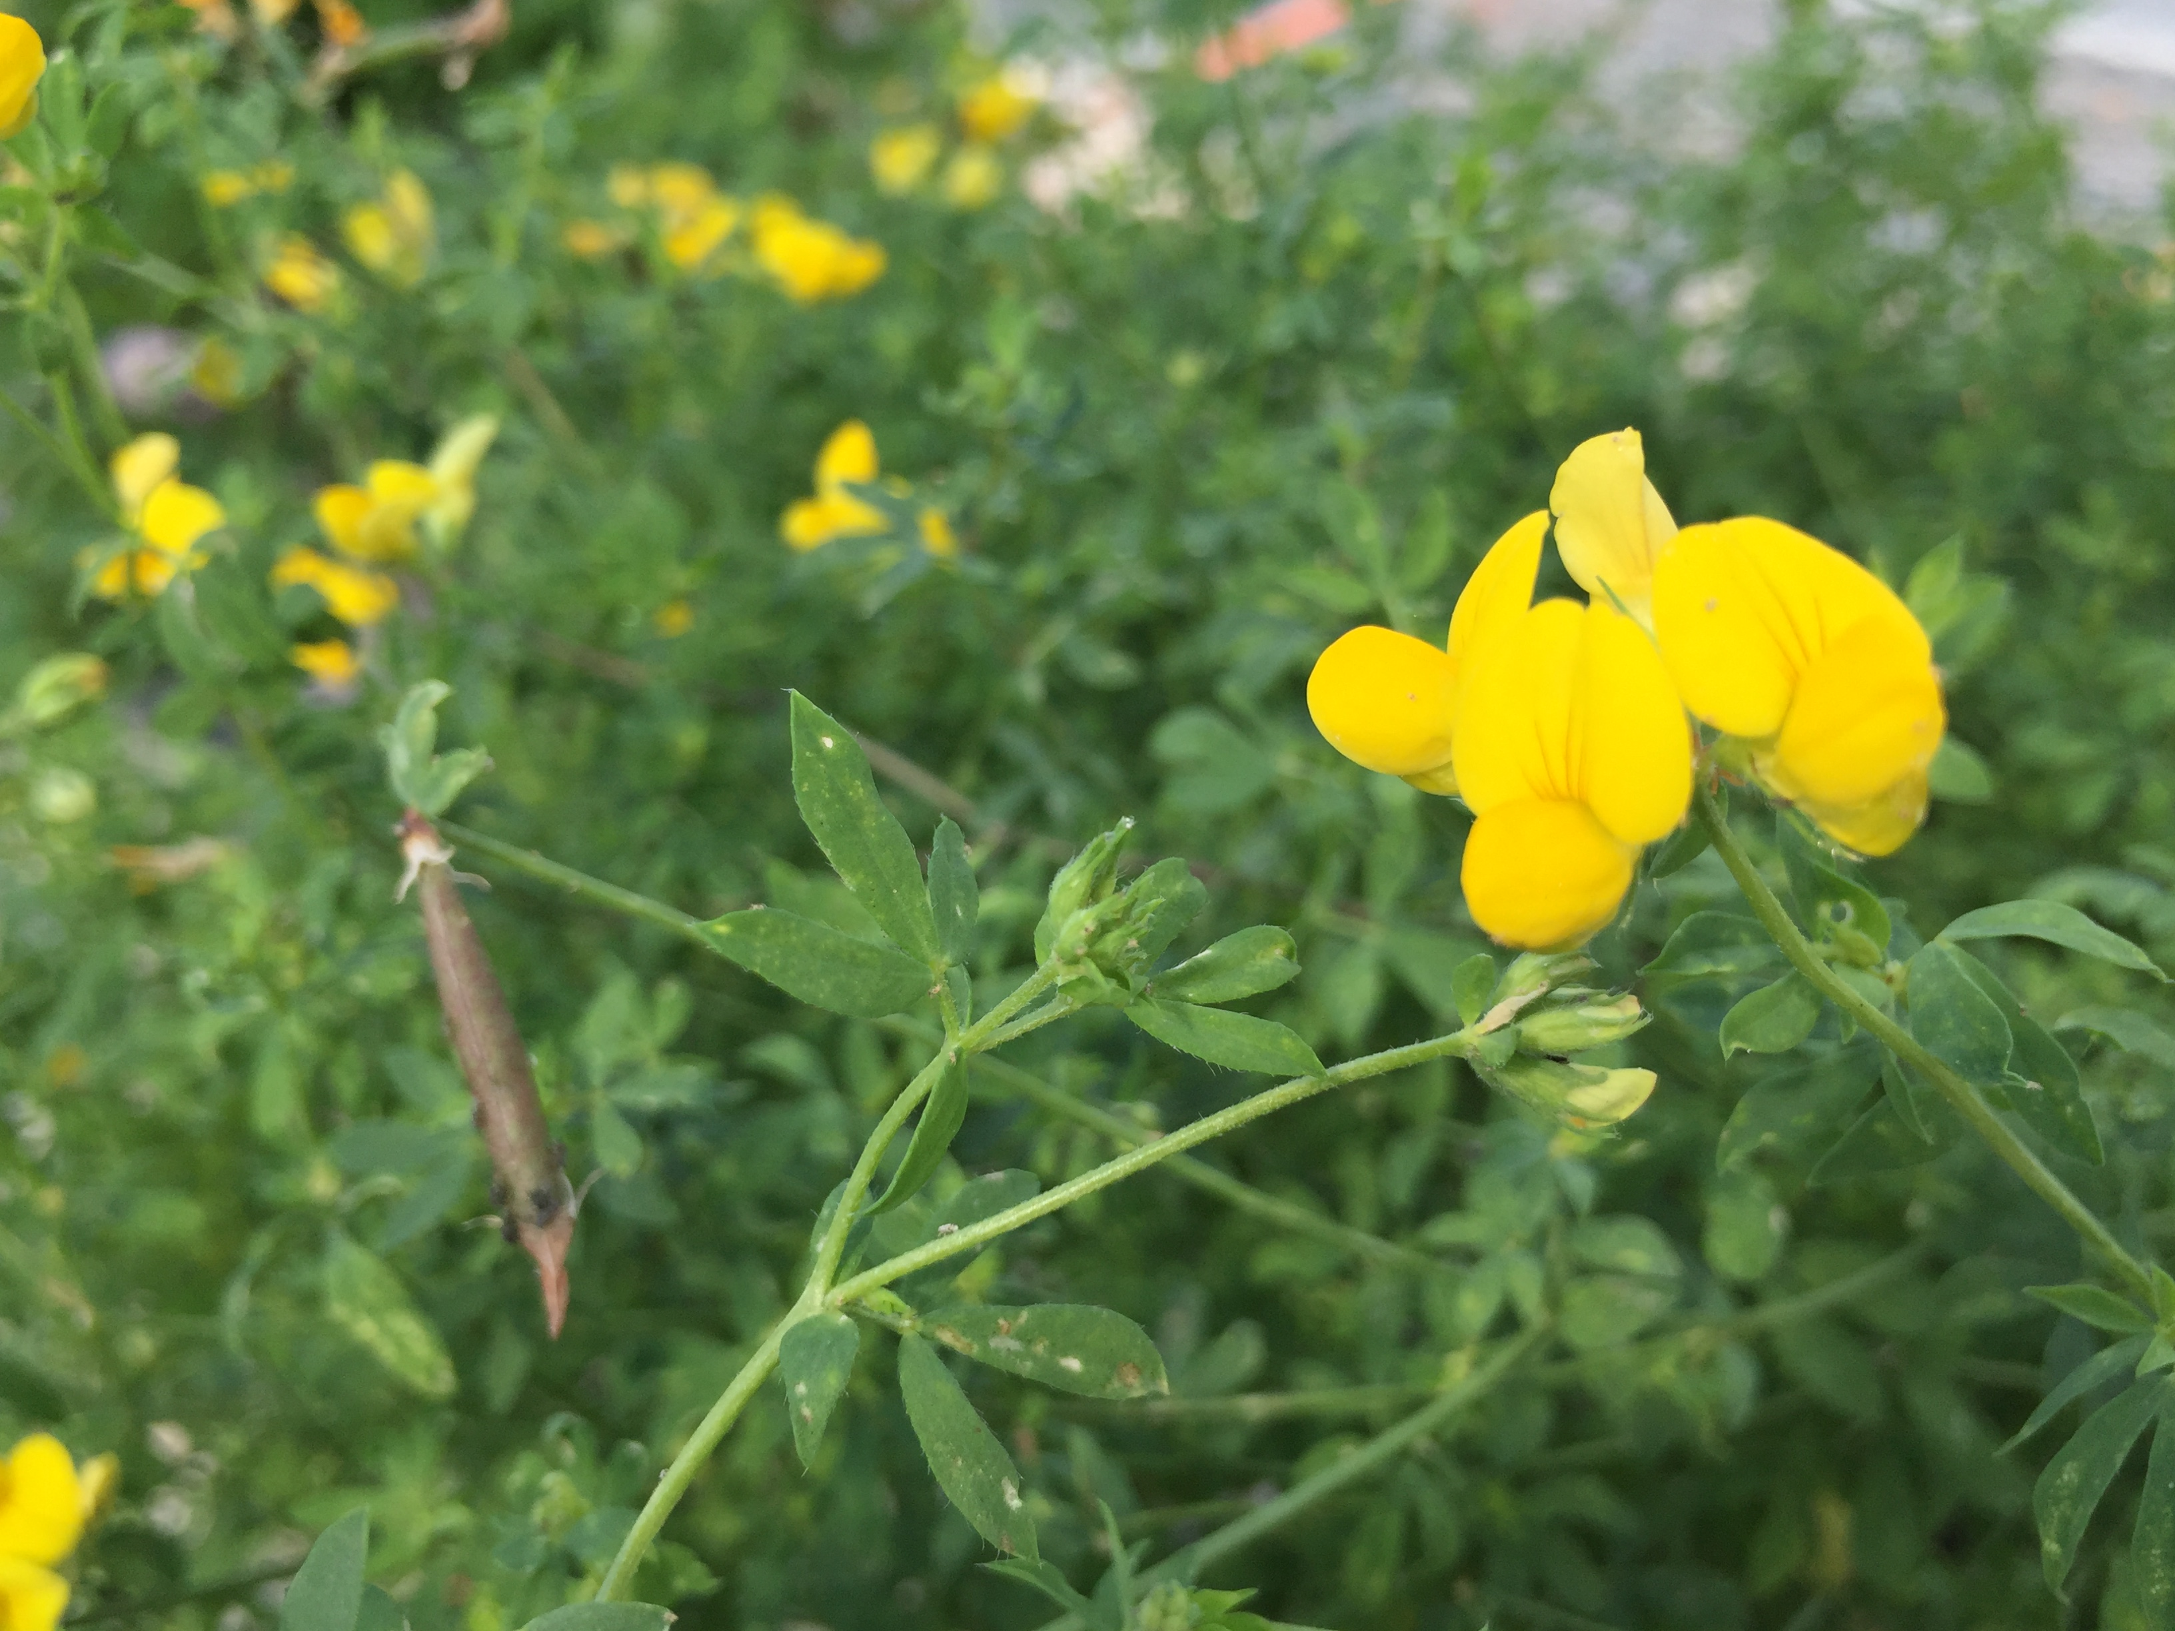
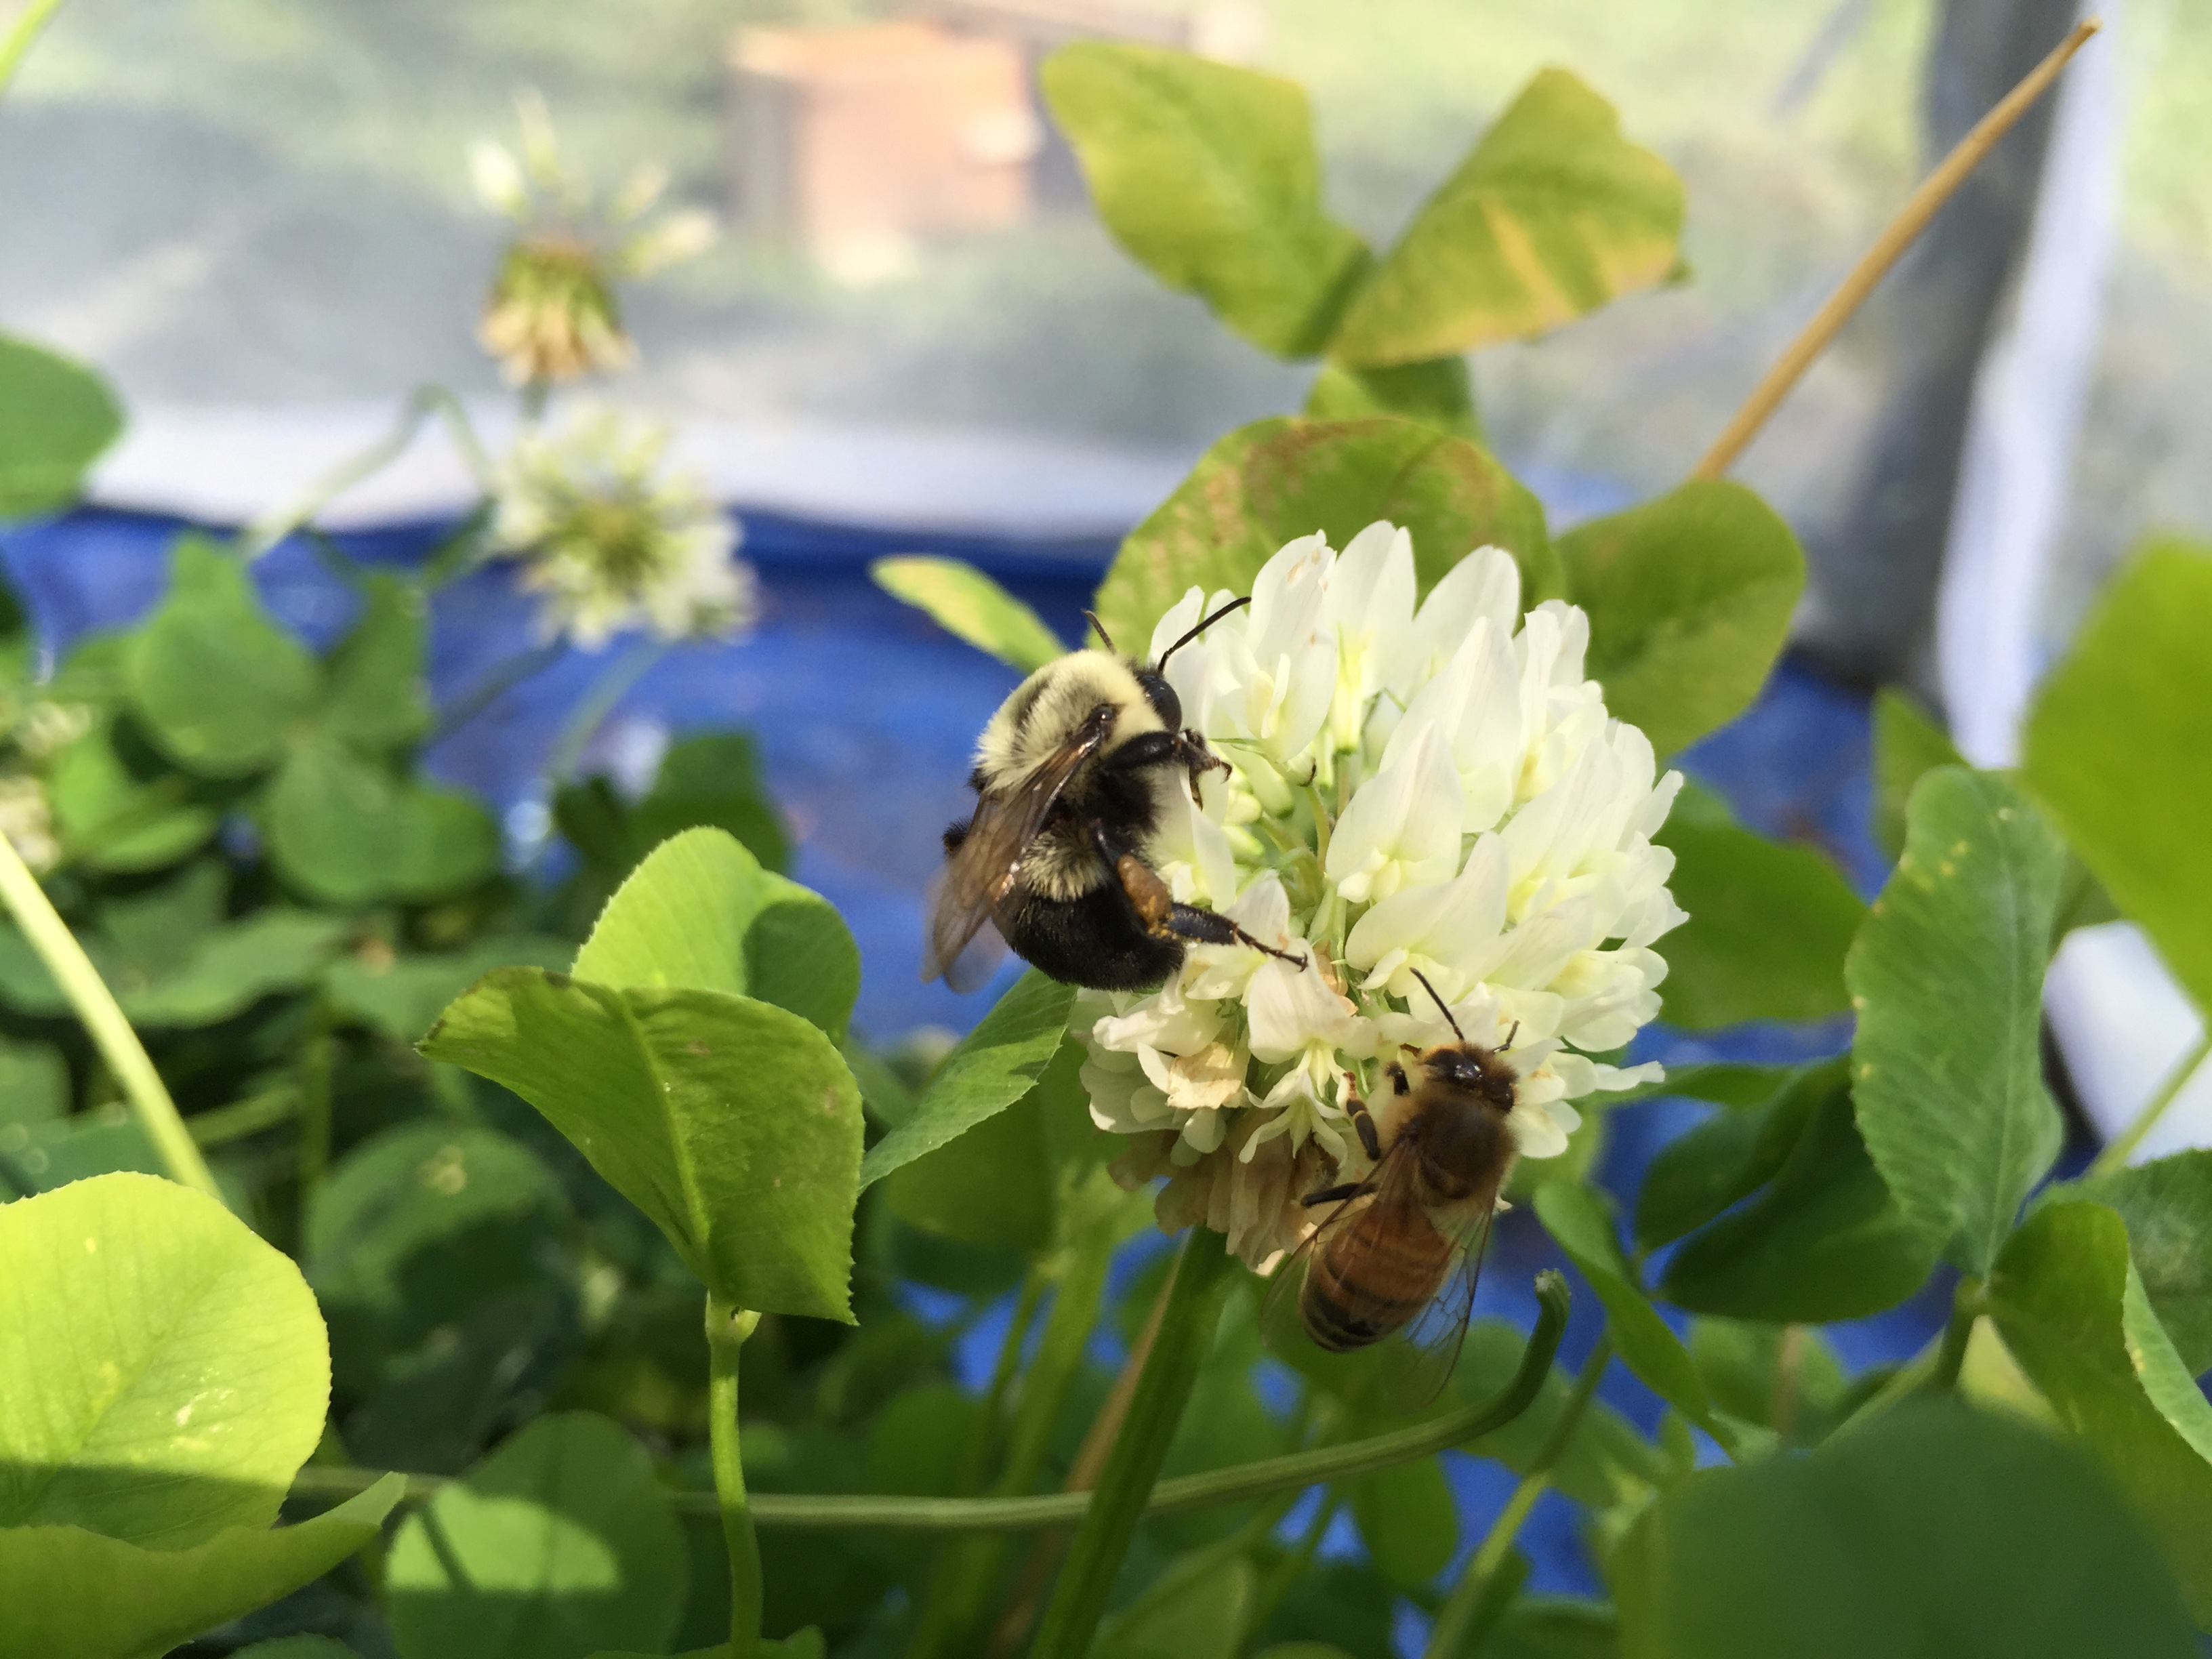
Role of Flowers in Virus Transmission?
Plant Species?
Plant Diversity?
Multiple Exposures?
Co-mingling?
Notes:
In examining the role of flowers in virus transmission, I asked:
Does Plant Species Matter? For examine, floral morphology may alter the way a bee comes in contact with the flower, increasing or decreasing the chance for viral deposition onto a flower.
Does Plant Diversity matter? When bees have diversity of plants to visit, will bees specialize on a preferred plant species and therefore be less likely to pass the virus through the less desirable plant species?
Do bees need to be exposed more than once to become infected?
And lastly,
Do bees need to touch directly, or co-mingle, on flowers to become infected?

Slide 30
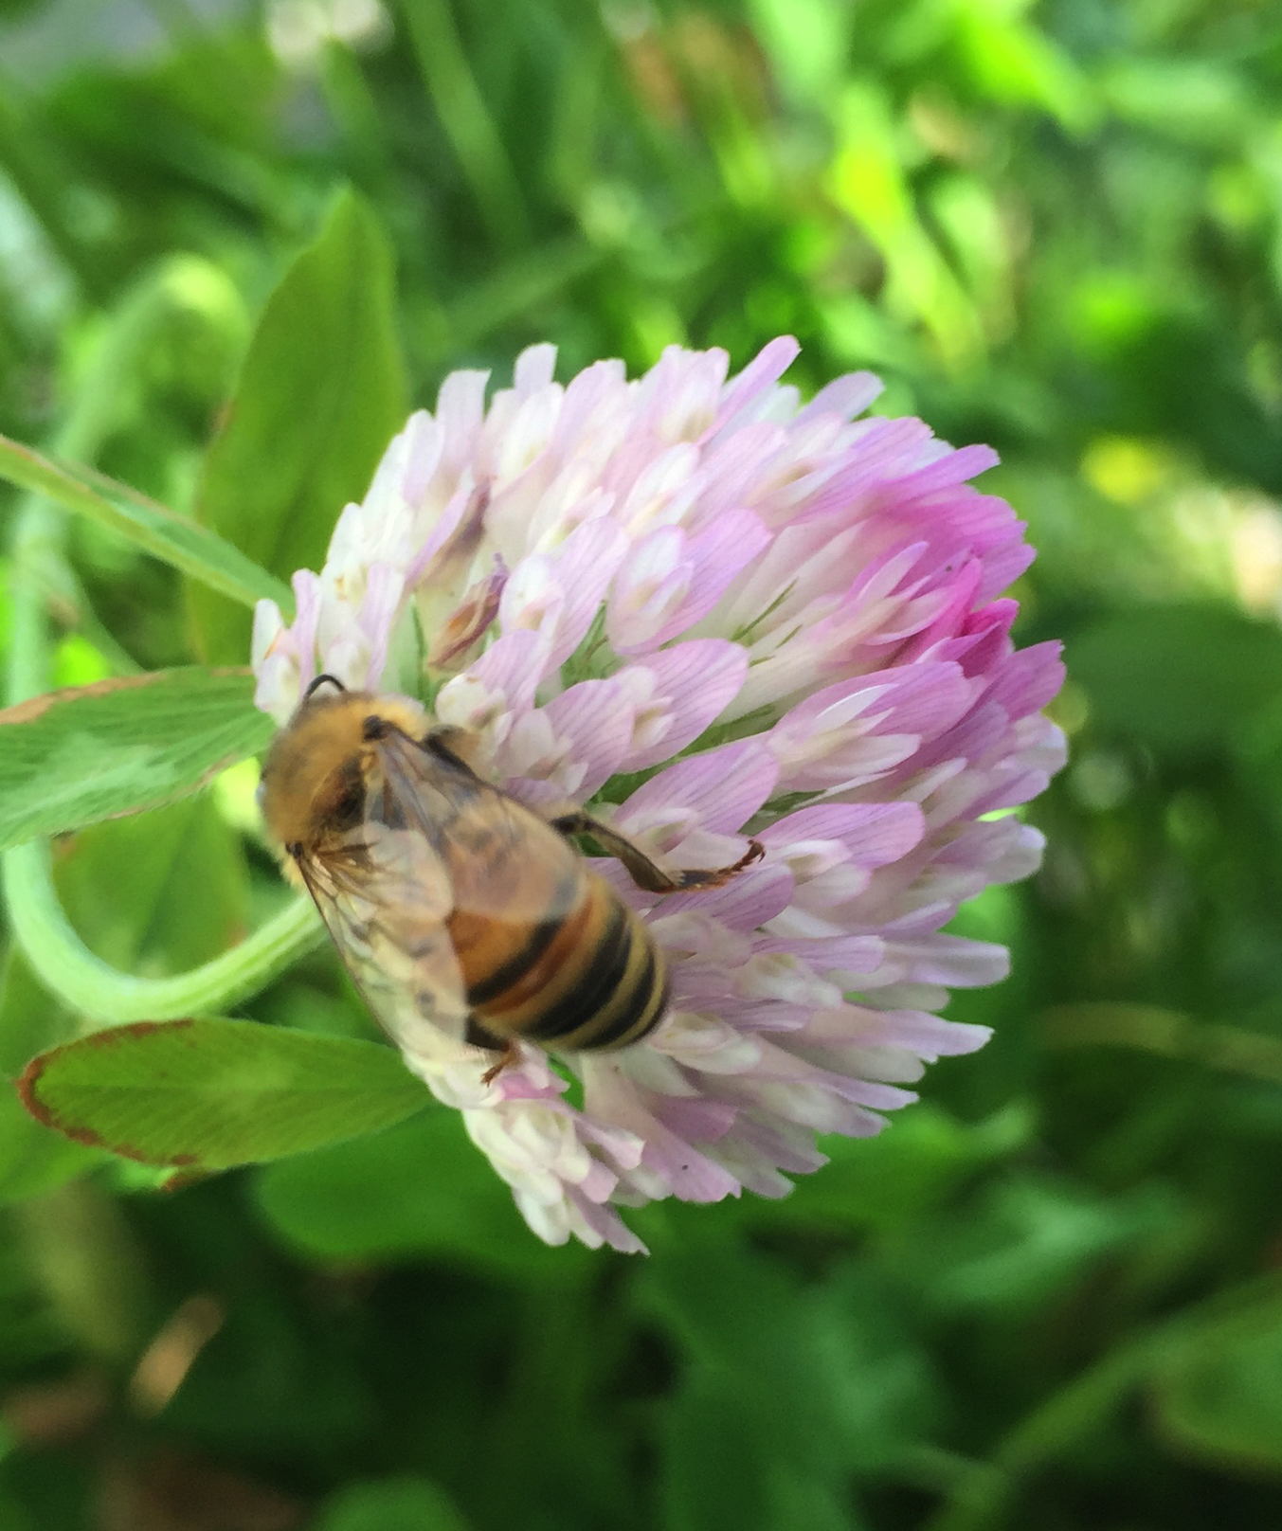
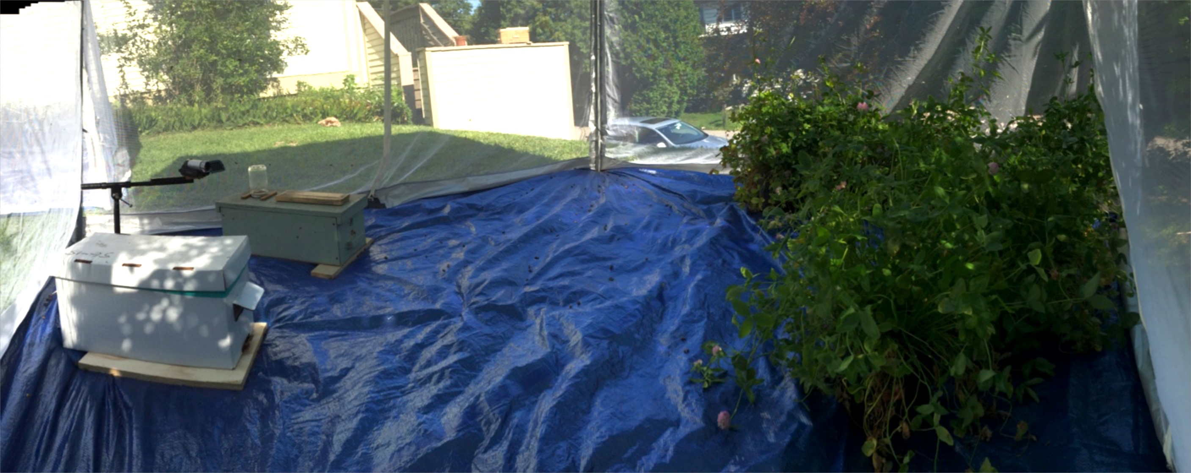
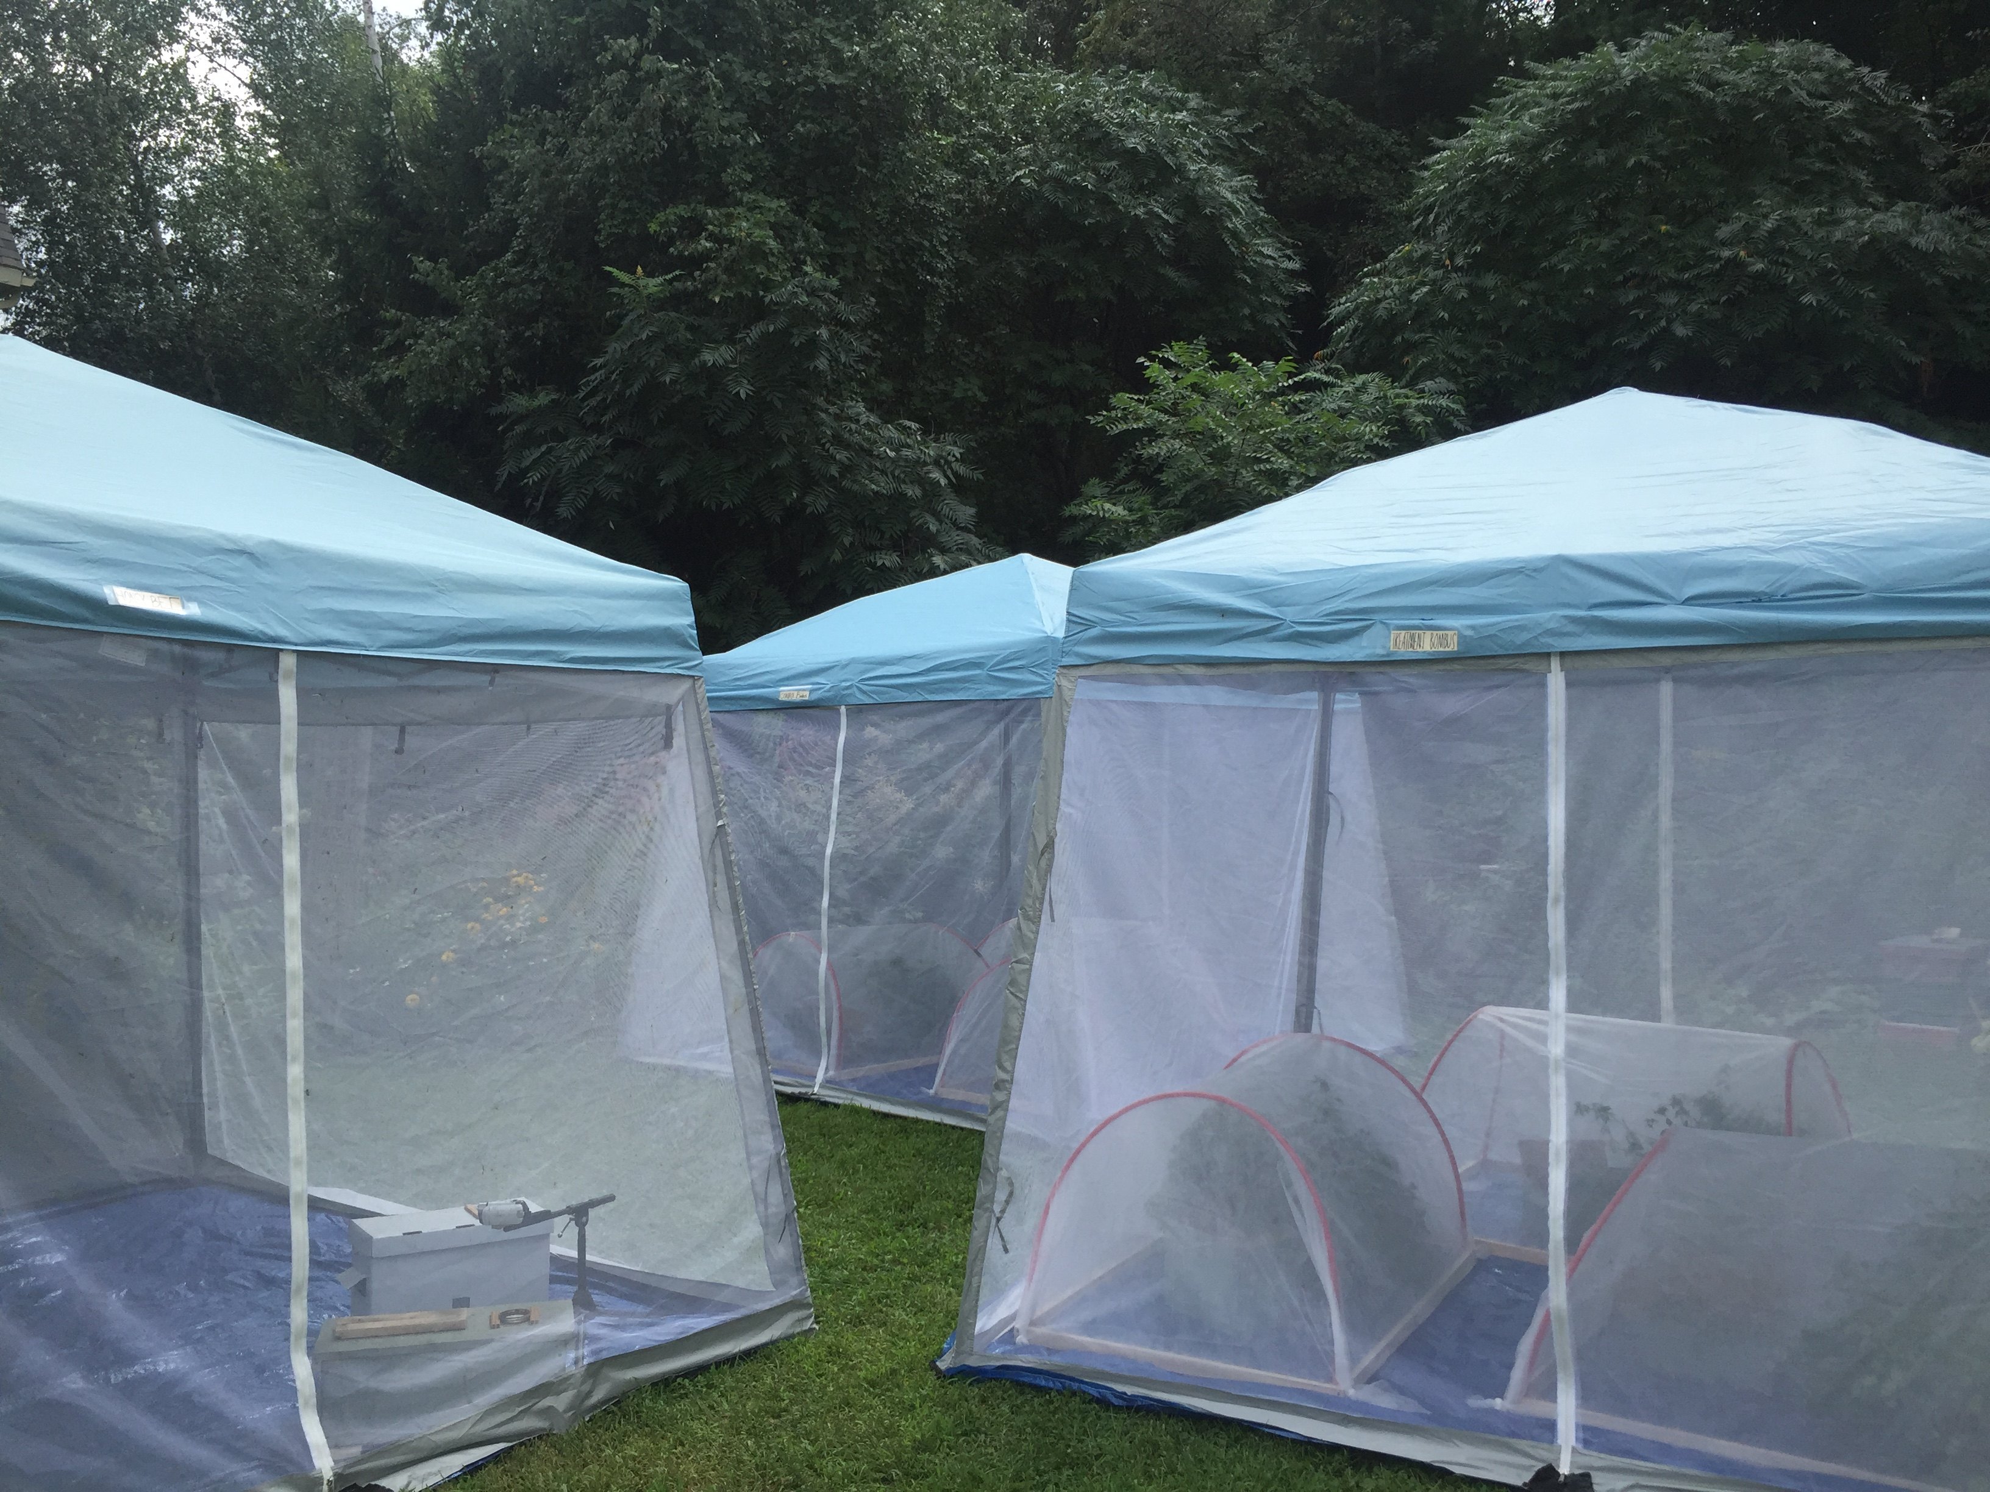
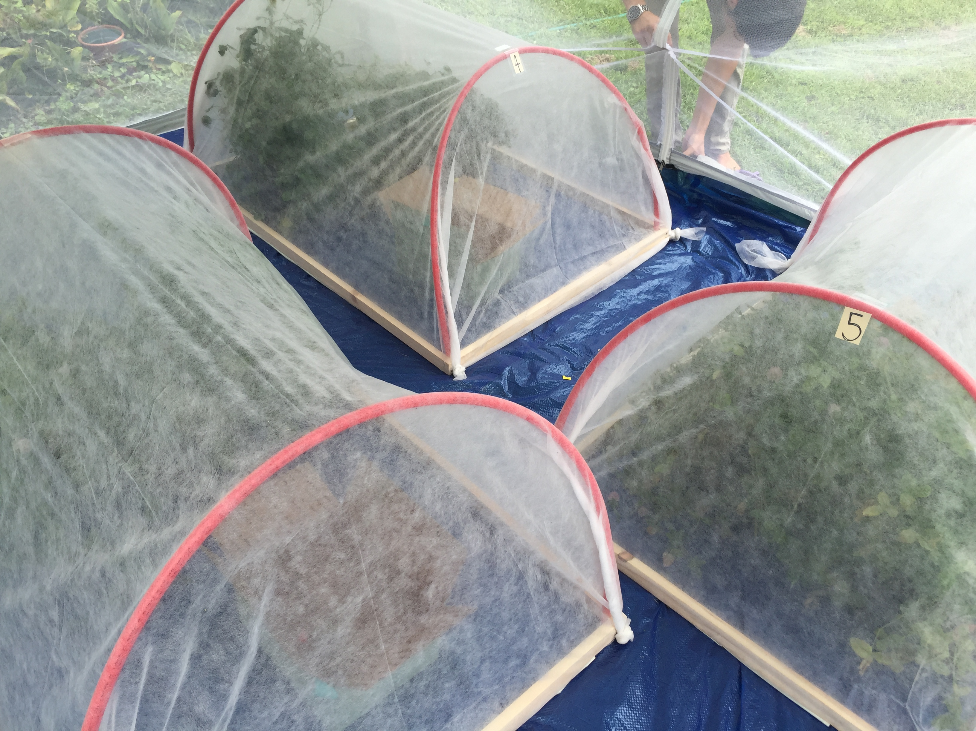


Slide 31


